Slide 1
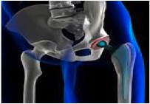
Attorney Client Privilege for Patents
Why is this important?
What is it?
Outside counsel v. inside counsel
Waiver
Special Topics
© 2015-2017 Kagan Binder, PLLC

Slide 2
The Party with secrets wins. The Party without secrets loses.
© Robseguin | Dreamstime.com - Man Playing Cards Photo
© Robseguin | Dreamstime.com - Man Playing Cards Photo

Slide 3
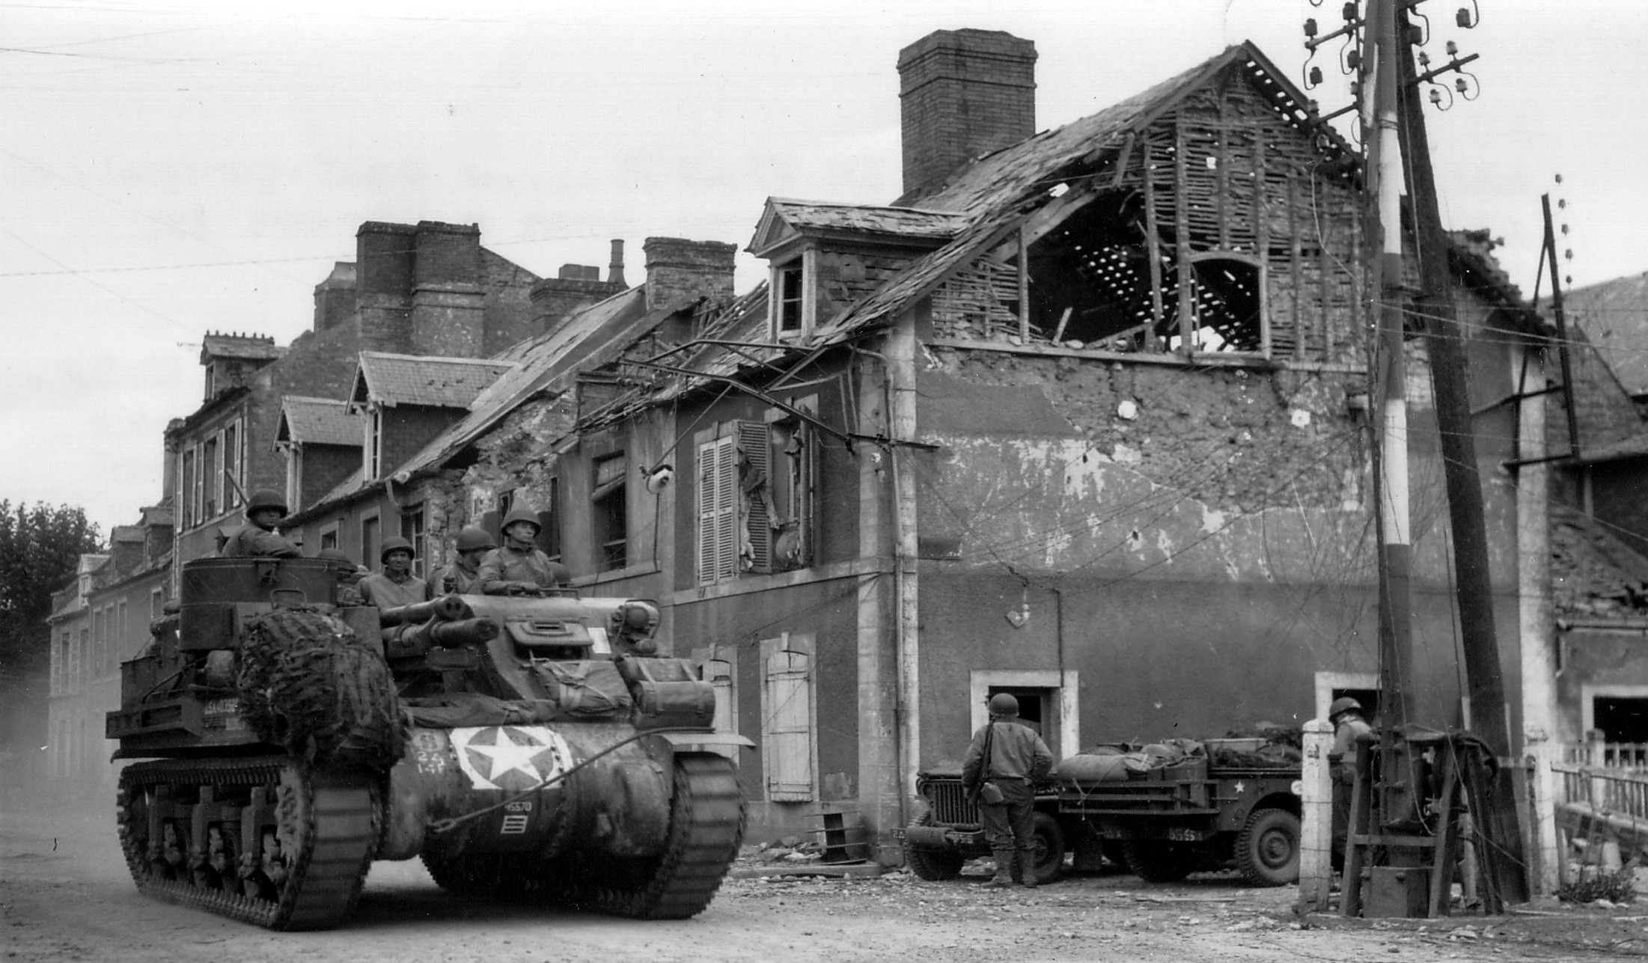
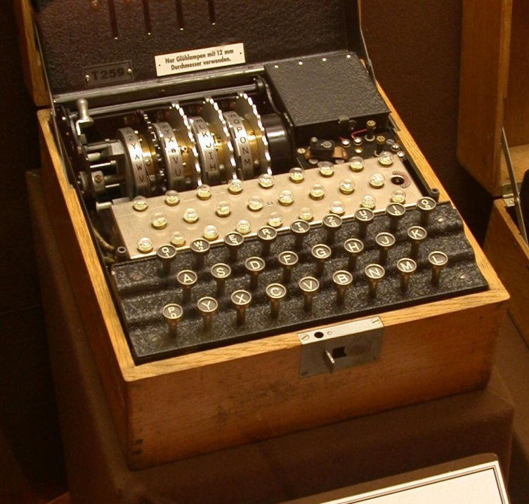
The Party with secrets wins. The Party without secrets loses.

Slide 4
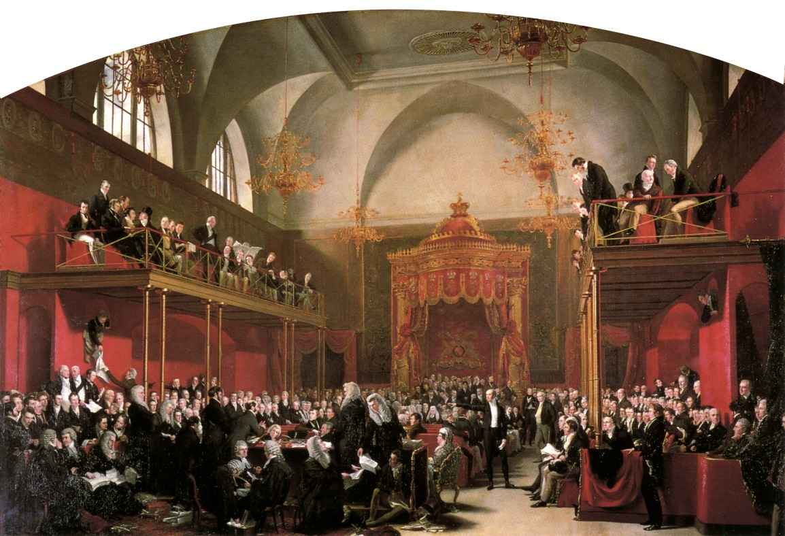
The Party with secrets wins. The Party without secrets loses.
Attorney-client communications are highly sensitive!
Legal advice
Legal strategies
Party who knows what other party is thinking has huge advantage
Problem: It’s hard to keep secrets in legal disputes.

Slide 5
Both parties must tell other side everything they know.
Documents
Emails
Pictures
Letters
Attachments
Notes
Reports
Presentations
Voice recordings
Videos/models
Testimony
Drawings
Specifications
Confidential or public
$$$ Penalties for failing to comply
Lose credibility with judge
Forfeit claims or defenses

Slide 6
Both must tell other side everything they know.
Documents
Emails
Pictures
Letters
Attachments
Notes
Reports
Presentations
Voice recordings
Videos/models
Testimony
Drawings
Specifications
But, there is an important exception. . .
Confidential or public
Penalties for failing to comply
Lose credibility with judge

Slide 7
Both must tell other side everything they know.
Documents
Emails
Pictures
Letters
Attachments
Notes
Reports
Presentations
Voice recordings
Videos/models
Testimony
Drawings
Specifications
No need to disclose PRIVILEGED attorney-client communications.
You don’t want your attorney to blab
You yourself don’t want to blab
Confidential or public
Penalties for failing to comply
Lose credibility with judge
Key to winning litigations
Key to company success.

Slide 8
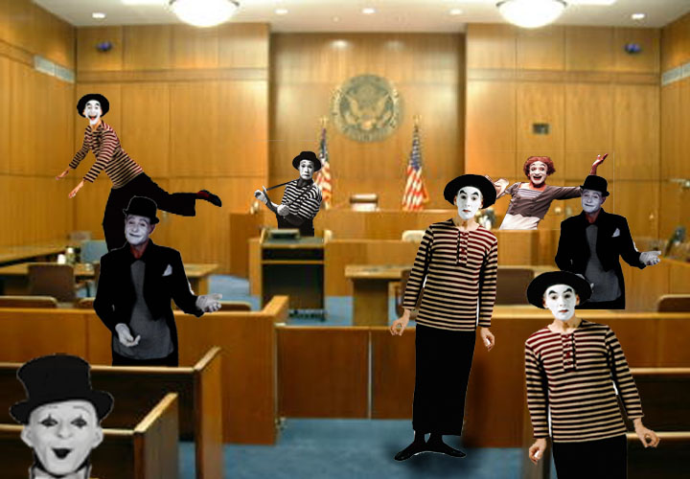
CAUTION: Take away the right message
The wrong messages:
Business communications are bad.
Avoid business communications.

Slide 9
CAUTION: Take away the right message
The wrong message:
Business communications are bad.
Avoid business communications.
Recognize communications where privilege is important
Plan and manage privileged communications
Ask for help first

Slide 10
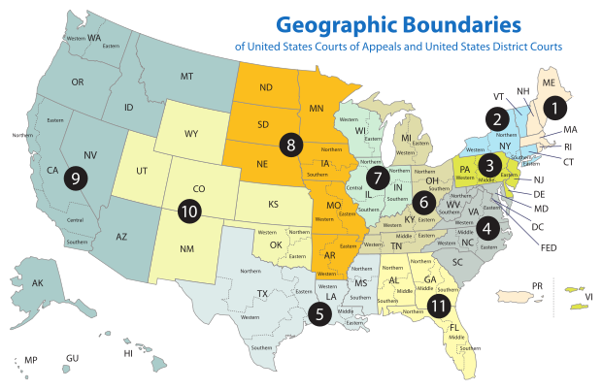
Privilege is different, depending on where you litigate.

Slide 11
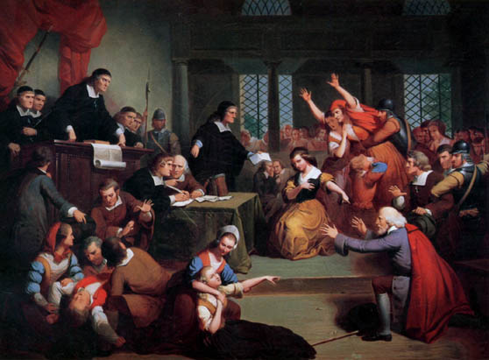
What is protected?
I swear to tell the truth, the whole truth, and nothing but the truth . . . Unless it’s privileged.
Protects legal (NOT BUSINESS) communications
Prohibits attorney from blabbing (ethics duties, too).
Protects client and attorney from being compelled to disclose protected communications

Slide 12
What is protected?
And then what did you ask your attorney?
Objection! Privileged!
Some communications(legal not business)
Prohibits attorney from blabbing.
Protects client from being compelled to disclose protected communications
Lasts forever. . . . . . Unless waived/exempt/bullied

Slide 13
Attorney Client Privilege Checklist
Communication (written, verbal, nonverbal)
Between attorney and client (actual or prospective)**
In Confidence
For purpose of legal advice

Slide 14
Attorney Client Privilege Checklist
X
Communication (written, verbal, nonverbal)
Between attorney and client (actual or prospective)**
In Confidence
For purpose of legal advice
X
X
X

Slide 15
Attorney Client Privilege Checklist
X
Communication (written, verbal, nonverbal)
Between attorney and client (actual or prospective)**
In Confidence
For purpose of legal advice
X
X

Slide 16
Attorney Client Privilege Checklist
X
Communication (written, verbal, nonverbal)
Between attorney and client (actual or prospective)**
In Confidence
For purpose of legal advice
X
Most fights
X
Most courts use similar checklist, slightly different words
Courts interpret the checklist differently
Often two different camps

Slide 17
Privilege or No Privilege?
1
© Americanspirit | Dreamstime.com - Large Crowd Of People At Event Photo
Good Guys personnel are in a meeting discussing whether to hire design firm or design holographic mirror internally.
No attorney present

Slide 18
Privilege or No Privilege?
2
© Americanspirit | Dreamstime.com - Large Crowd Of People At Event Photo
Good Guys personnel are in a meeting discussing whether to hire design firm or design holographic mirror internally.
Attorney present

Slide 19
Privilege or No Privilege?
3
© Americanspirit | Dreamstime.com - Large Crowd Of People At Event Photo
Good Guys personnel are in a meeting discussing legal ramifications of hiring a design firm or developing inhouse.
Attorney present

Slide 20
Privilege or No Privilege?
4
© Americanspirit | Dreamstime.com - Large Crowd Of People At Event Photo
Good Guys personnel are in a meeting discussing legal ramifications of hiring a design firm or developing inhouse.
Attorney present. Third party consultant present.

Slide 21
Privilege or No Privilege?
4
Agents of the lawyer or client may be privy to lawyer-client communications without the privilege being lost so long as the involvement of the agent facilitates the rendering of legal advice.
Common interest?
© Americanspirit | Dreamstime.com - Large Crowd Of People At Event Photo
Good Guys personnel are in a meeting discussing legal ramifications of hiring a design firm or developing inhouse.
Attorney present. Third party consultant present.

Slide 22
Privilege or No Privilege?
5
© Americanspirit | Dreamstime.com - Large Crowd Of People At Event Photo
ALL Good Guys personnel are in a meeting discussing legal ramifications of hiring a design firm or developing inhouse.
Attorney present

Slide 23
Privilege or No Privilege?
6
© Americanspirit | Dreamstime.com - Large Crowd Of People At Event Photo
Good Guys personnel are in a meeting discussing legal ramifications of hiring a design firm or developing inhouse. Also discussing whether power draw of heater controller is too high.
Attorney present.

Slide 24
Privilege or No Privilege?
7
“Reverse Attorney”
© Americanspirit | Dreamstime.com - Large Crowd Of People At Event Photo
Good Guys personnel are in a meeting discussing legal ramifications of hiring a design firm or developing inhouse.
No attorney present.

Slide 25
Privilege or No Privilege?
CONFIDENTIAL AND PRIVILEGED
Technical technical technical. Business.
Technical technical technical. Business.
Technical technical technical. Business.
Technical technical technical. Business.
Technical technical technical. Business.
Technical technical technical. Business.
Technical technical technical. Business.
Calling something privileged does not make it privileged
Real purpose of content controls.
This behavior can jeopardize privilege more widely.

Slide 26
Privilege or No Privilege?
CONFIDENTIAL AND PRIVILEGED
To: Attorney
CC: Attorney
From: Sally in the lab
Technical technical technical. Business.
Technical technical technical. Business.
Technical technical technical. Business.
Technical technical technical. Business.
Technical technical technical. Business.
Technical technical technical. Business.
Technical technical technical. Business.
Sending to attorney does not make it privileged
Real purpose of content controls.
Business/technical, not legal.

Slide 27
Privilege or No Privilege?
CONFIDENTIAL AND PRIVILEGED
TO: Attorney
From: Bob in the Lab
I’m thinking legal. Legal. Legal. Legal. Therefore, Legal. And moreover, legal, legal, legal.
Legal. Legal. Legal. Legal. Therefore, Legal. And moreover, legal, legal, legal.
Legal. Legal. Legal. Legal. Therefore, Legal.
And moreover, legal, legal, legal.
Legal. Legal. Legal. Legal. Therefore, Legal. And moreover, legal, legal, legal.
Thanks, no need to respond.
This is not privileged.
Real purpose of content controls.
Reverse attorney.

Slide 28
Privilege or No Privilege?
CONFIDENTIAL AND PRIVILEGED
To: Attorney
Need legal help. Some details. A few more details. Some concerns. Some goals.
This is privileged.
Real purpose of content controls.
Seeking legal advice.
Classic privilege.

Slide 29
Privilege or No Privilege?
CONFIDENTIAL AND PRIVILEGED
From: Attorney
To: Business team with need to know
Legal. Legal. Legal. Legal. Therefore, Legal. And moreover, legal, legal, legal.
Legal. Legal. Legal. Legal. Therefore, Legal. And moreover, legal, legal, legal.
Legal. Legal. Legal. Legal. Therefore, Legal. And moreover, legal, legal, legal.
Legal. Legal. Legal. Legal. Therefore, Legal. And moreover, legal, legal, legal.
This is privileged.
Real purpose of content controls.
Classic privilege

Slide 30
Privilege or No Privilege?
CONFIDENTIAL AND PRIVILEGED
From: Attorney
To: Business team with need to know
Legal. Legal. Legal. Legal. Therefore, Legal. And moreover, legal, legal, legal.
Legal. Legal. Legal. Legal. Therefore, Legal. And moreover, legal, legal, legal.
Legal. Legal. Legal. Legal. Therefore, Legal. And moreover, legal, legal, legal.
Legal. Legal. Legal. Legal. Therefore, Legal. And moreover, legal, legal, legal.
This is privileged. . . But potentially waived
Real purpose of content controls.
Forwarding legal advice risks privilege
Others.
Howard forwards

Slide 31
Privilege or No Privilege?
CONFIDENTIAL AND PRIVILEGED
From: Attorney
To: Business team and everybody on 6th floor plus 5th floor
Legal. Legal. Legal. Legal. Therefore, Legal. And moreover, legal, legal, legal.
Legal. Legal. Legal. Legal. Therefore, Legal. And moreover, legal, legal, legal.
Legal. Legal. Legal. Legal. Therefore, Legal. And moreover, legal, legal, legal.
Legal. Legal. Legal. Legal. Therefore, Legal. And moreover, legal, legal, legal.
This is privileged . . . But potentially waived
Real purpose of content controls.
Classic loss of privilege

Slide 32
Privilege or No Privilege?
From: Attorney
Legal. Legal. Legal. Legal. Therefore, Legal. And moreover, legal, legal, legal.
Legal. Legal. Legal. Legal. Therefore, Legal. And moreover, legal, legal, legal.
Legal. Legal. Legal. Legal. Therefore, Legal. And moreover, legal, legal, legal.
Legal. Legal. Legal. Legal. Therefore, Legal. And moreover, legal, legal, legal.
This potentially is not privileged
Real purpose of content controls.
Do you see why privilege is at risk?

Slide 33
Privilege or No Privilege?
From: Attorney
Legal. Legal. Legal. Legal. Therefore, Legal. And moreover, legal, legal, legal.
Legal. Legal. Legal. Legal. Therefore, Legal. And moreover, legal, legal, legal.
Legal. Legal. Legal. Legal. Therefore, Legal. And moreover, legal, legal, legal.
Legal. Legal. Legal. Legal. Therefore, Legal. And moreover, legal, legal, legal.
This potentially is not privileged . . . For practical reasons
Real purpose of content controls.
Without PRIVILEGED legend, accidental disclosure more likely.
Potential waiver.

Slide 34
Privilege or No Privilege?
CONFIDENTIAL AND PRIVILEGED
To: Business team
From: Business leader
CC: Attorney
Team: This is what might be happening.
Legal. Legal. Legal. Legal. Therefore, Legal. And moreover, legal, legal, legal.
Legal. Legal. Legal. Legal. Therefore, Legal. And moreover, legal, legal, legal.
Legal. Legal. Legal. Legal. Therefore, Legal. And moreover, legal, legal, legal.
Legal. Legal. Legal. Legal. Therefore, Legal. And moreover, legal, legal, legal.
This probably is not privileged.
Real purpose of content controls.
Reverse attorney

Slide 35
Practice Tips
Use CONFIDENTIAL AND PRIVILEGED properly.
Know when NOT to use CONFIDENTIAL AND PRIVILEGED
Don’t label everything CONFIDENTIAL AND PRIVILEGED
Plan distribution and follow your plan
Ask for help

Slide 36
More practice tips
Separate business and legal meetings/documentation
Be clear when requesting legal advice
Be clear when giving legal advice
Be clear when providing information responsive to attorney request
Avoid reverse lawyering
Learn how to ask for legal advice

Slide 37
Even more practice tips
Learn how to act on legal advice
Plan legal communications in advance WITH ATTORNEY
Educate your team
Use the phone or office or conference room
Think twice before communicating
Use CONFIDENTIAL widely, but common sense applies

Slide 38
ACTING ON LEGAL ADVICE
Memo:
To: Team
From: Stan in Management
We don’t infringe. Apparently we don’t have a “molten intermetallic composition” per the claims, although Bob disagrees. So, I guess go ahead and keeping going with Design 1051-B. Keep our fingers crossed we don’t get sued.
Memo:
To: Team
From: Stan in Management
This authorizes you to proceed with Design 1051-B.
Not so good.
Better.

Slide 39
ACTING ON LEGAL ADVICE
Memo:
To: Team
From: Stan
This authorizes you to proceed with Design 1051-B.
Reply Memo:
From: Susan
To: Team and everybody
Okay. But I can’t really fathom how legal could say we don’t infringe. What did legal say? I read the patent. It’s dead on.
______________________
Memo:
To: Team
From: Stan
This authorizes you to proceed with Design 1051-B.
Better.
Darn.

Slide 40
Still more practice tips
Control distribution and re-distribution of legal advice
Recognize legal v. business communications
Sometimes the best communication is no communication
Assume every business document will be in a dispute
Disclosed (under protective order), or
Privileged

Slide 41
Who is the attorney?
Timing
Inhouse counsel v. outside counsel
Patent attorneys
Patent agents
International Associates
Reverse attorney

Slide 42
Timing: Does privilege apply when you are just kicking the tires?
Old rule: No.
Modern trend: Yes
Depends on judge
Tip: Tiptoe into relationship
“Prospective client”
Litigation Securities Employment Contract Patent
© Rawpixelimages | Dreamstime.com - Business People Shaking Hands In New York City Photo

Slide 43
Timing: Does privilege apply when you are just kicking the tires?
Minnesota:
MN Rule 1.18 Duties to Prospective Client
A person who discusses with a lawyer the possibility of forming a client-lawyer relationship with respect to a matter is a prospective client.
Even when no client-lawyer relationship ensues, a lawyer who has had discussions with a prospective client shall not use or reveal information learned in the consultation, except as Rule 1.9 would permit with respect to information of a former client. . . .
This is only HALF the privilege picture!

Slide 44
Can the MN attorney refuse to provide information that is confidential but not privileged?
Minnesota:
MRPC Rule 1.6(b)(2) provides that a lawyer may reveal secrets when required by law.
Rule 26, R. Civ. Proc., requires an answer to relevant discovery unless there is a privilege.
MRPC Rule 3.4(c) requires a lawyer to obey court rules.
U.S. v. Sindel, 53 F.3d 874 (8th Cir. 1995) holds that Rule 1.6 does not protect non-privileged material from an IRS summons.
Note: This issue applies both to prospective and actual client relationships.
Recommendation: Be an advocate.

Slide 45
Timing: Does privilege apply when you are just kicking the tires?
California code:
The Evidence Code defines a "client" as a person who "consults a lawyer for the purpose of retaining the lawyer or securing legal service or advice from him in his professional capacity." Evid. Code ¤ 951. Thus, one may be a "client" under the attorney-client privilege, without ever entering into an attorney-client relationship.
Thumbs up in California.

Slide 46
Timing: Does privilege apply when you are just kicking the tires?
California case law:
It is well established that the attorney-client privilege may apply to preliminary communications with an attorney made for the purpose of securing representation, provided that there is a reasonable expectation that the attorney will provide representation. See People v. Gionis (1995) 9 Cal. 4th 1196, 40 Cal.Rptr.2d 456, 892 P.2d 1199. The rationale for this rule is clear. As one court put it:
[N]o person could ever safely consult an attorney for the first time with a view to his employment if the privilege depended on the chance of whether the attorney after hearing his statement of the facts decided to accept the employment or decline it.
TWO thumbs up in California.

Slide 47
Privilege extends to patent attorneys in federal cases.
In re Spalding Sports Worldwide Inc., 203 F.3d 800 (Fed. Cir. 2000).
Client communications with patent counsel, including technical information, are for the purpose of seeking legal advice and areprotected by privilege. Patent attorneys provide counsel as other attorneys do and are not mere scribes or conduits.

Slide 48
Inside v. Outside: Upside or Downside?
Does attorney client privilege apply to inside counsel?
If yes, what are key differences in how privilege applies to inhouse and outside counsel?

Slide 49
Inside v. Outside: Upside or Downside?
Does attorney client privilege apply to inside counsel?
Absolutely. At least today. But really sensitive legal work should be handled with outside counsel due to the difference in a key burden of proof.

Slide 50
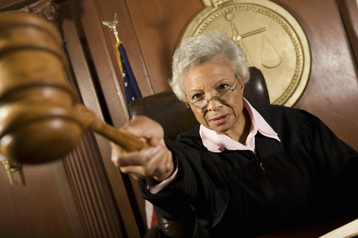
Attorney Client Privilege is easier to waive for inside counsel
What the courts have said:
Less objective
Business and legal hats
More likely necessary witness
Unfavorable burden of proof.
© Photographerlondon | Dreamstime.com - Judge Pointing Gavel In Courtroom Photo
Only the last three reasons make sense.

Slide 51
Unfavorable burden of proof
Outside counsel:
Presumed to be privileged.
Opponent must attack privilege for EACH document.
You get to keep secret unless opponent wins privilege battle
Inside Counsel:
Presumed NOT to be privileged.
You must prove privilege for EACH document
You must disclose unless you win privilege battle.
TIP: Use outside counsel for certain sensitive matters

Slide 52
Can Patent Agent Communications be privileged in some venues?
Patent agent:
Non-attorney
Technical degree
Federally registered with USPTO
Authorization: U.S. patentability, preparation, prosecution
Less expensive but capable option
© Monkeybusinessimages | Dreamstime.com - Businesswoman Working At Desk Photo
© Nyul | Dreamstime.com - Businessman Working At Desk Photo

Slide 53
Are Patent Agent Communications privileged?
Yes.
No.
© Monkeybusinessimages | Dreamstime.com - Businesswoman Working At Desk Photo
© Nyul | Dreamstime.com - Businessman Working At Desk Photo

Slide 54
Can Patent Agent Communications be privileged in some venues?
Yes.
No.
© Monkeybusinessimages | Dreamstime.com - Businesswoman Working At Desk Photo
© Nyul | Dreamstime.com - Businessman Working At Desk Photo

Slide 55
Can Patent Agent Communications be privileged in some venues?
Yes.
No.
© Monkeybusinessimages | Dreamstime.com - Businesswoman Working At Desk Photo
© Nyul | Dreamstime.com - Businessman Working At Desk Photo

Slide 56
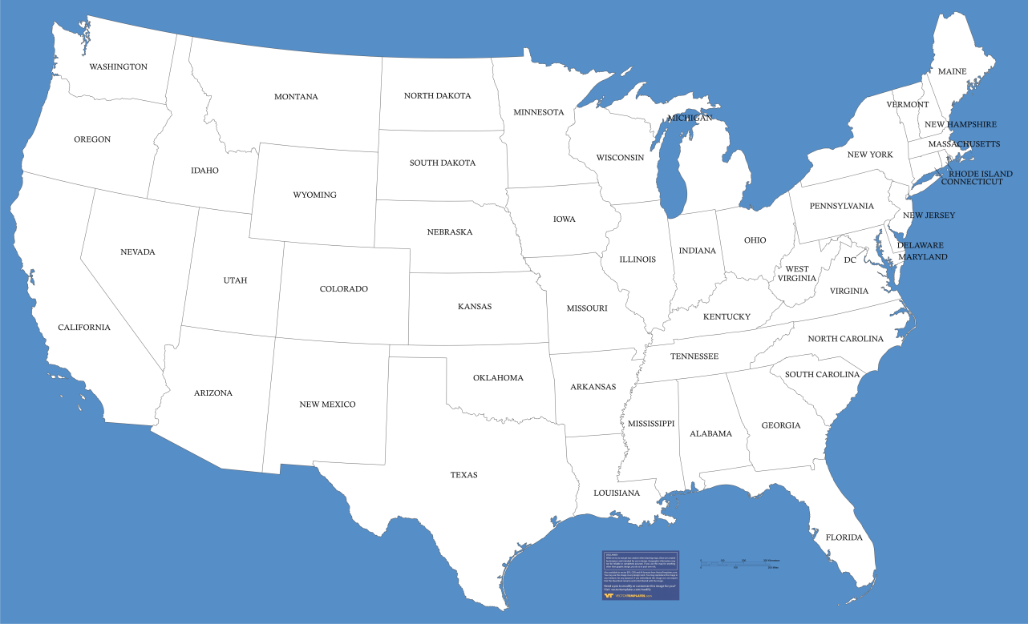
Patent Agents Communications can be privileged in some venues
YES
No
YES
YES
YES
No
No
No
YES
No
Pre-2016

Slide 57
March 2016: Federal Circuit extends privilege to patent agents
In re Queens University, (Fed. Cir. 2016)
“[W]e find that the unique roles of patent agents, the congressional recognition of their authority to act, the Supreme Court’s characterization of their activities as the practice of law, and the current realities of patent litigation counsel in favor of recognizing an independent patent-agent privilege.”

Slide 58
March 2016: Federal Circuit extends privilege to patent agents
Five months later, August 2016, Texas refuses to extend privilege to patent agents in a state contract dispute.
Cited and dismissed In re Queens (Fed Cir 2016) as being decided under federal law, not the law of the great state of Texas
State law controls this contract case
Texas won’t create another common law privilege
Leaves open possibility for Texas legislature to extend the privilege under a statute. Not likely.

Slide 59
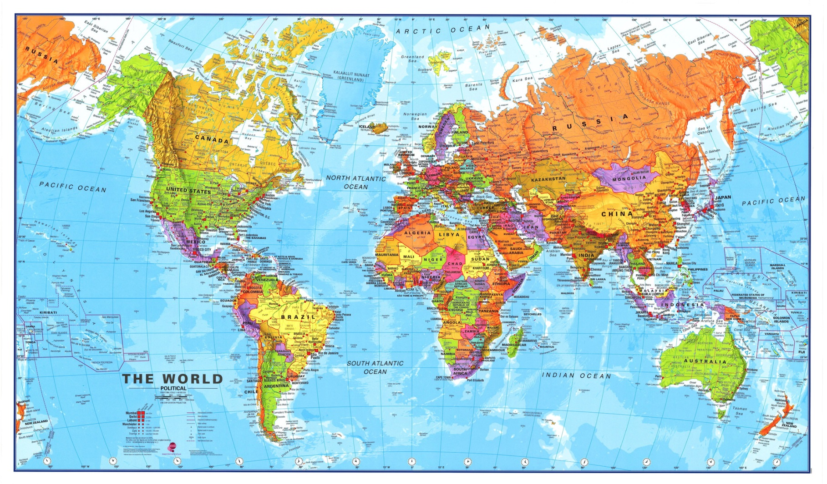
International associate communications can be privileged for some venues

Slide 60
International associate communications can be privileged in some US venues
Privilege:
Japan (>1998) Germany United Kingdom France
No Privilege:
France (if litigating in S. D. New York)
No Supreme Court or Federal Circuit cases.

Slide 61
Who is the client in the corporate world?
Company is a legal construct
Company acts through its people
Company is the client
Company controls privilege

Slide 62
Corporate privilege is like a club membership.
Only some employees are eligible
Project specific
Might be eligible for Project A, but not Project B
See Diversified Industries, Inc. v. Meredith, 572 F.2d 596 (8th Cir. 1977) (guidance on who is in the “circle of privilege”).
In re Bieter Company, 16 F.3d 929 (8th Cir. 1994)(non-employee outside consultants canbe within the circle of privilege if regularly involved in assisting the company in important decision-making, including acting on the advice of counsel).

Slide 63
How do you know if you are eligible for privilege on a project?
Depends on where you are!
Old law: Control group test
Subject Matter Test
Employee at time of communication
Superior authorized communication
Within scope of employment duties
Upjohn warning (internal investigation)???

Slide 64
Some venues, Upjohn warning required for internal investigations
Main elements:
Counsel for company, not you
Communication is privileged, but Company owns the privilege, not you
Company can choose to waive
Potential conflicts of interest (See U.S. v. Ruehle, 9th Cir. 2009)
Document!

Slide 65
Some venues, Upjohn warning required for internal investigations
ABA Upjohn recommendation for white collar crime:
I am a lawyer for Corporation A. I represent only Corporation A, and I do not represent you personally.
I am conducting this interview to gather facts in order to provide legal advice for Corporation A. This interview is part of an investigation to determine the facts and circumstances of X in order to advise Corporation A how best to proceed.
Your communications with me are protected by the attorney-client privilege. But the attorney-client privilege belongs solely to Corporation A, not you. That means Corporation A alone may elect to waive the attorney-client privilege and reveal our discussion to third parties. Corporation A alone may decide to waive the privilege and disclose this discussion to such third parties as federal or state agencies, at its sole discretion, and without notifying you.
In order for this discussion to be subject to the privilege, it must be kept in confidence. In other words, with the exception of your own attorney, you may not disclose the substance of this interview to any third party, including other employees or anyone outside of the company. You may discuss the facts of what happened but you may not discuss this discussion.
Do you have any questions?
Are you willing to proceed?

Slide 66
Confidentiality: Reasonable expectation of secrecy
Non-confidential communications are not privileged.
3d party present
Public place
Overbroad distribution or re-distribution
??Hidden listening devices/theft/etc.??
© Damedeeso | Dreamstime.com - See No Evil, Hear No Evil, Speak No Evil Photo

Slide 67
Privilege only protects if seeking or obtaining legal advice
Business advice not eligible at all.
Mixing law and business in the same communications jeopardizes privilege
Inhouse counsel wears business and legal hats
© Mcgrewc | Dreamstime.com - Two Outback Style Hats One Green One Brown Isolated On White Photo

Slide 68
Some facts not eligible for privilege.
Existence of the attorney client relationship.
Length of the relationship.
General nature of the legal services.
Communication “specifications”
Dates
Persons
Length
Calendar entries
Fee arrangement
place

Slide 69
Waiver: Privilege has a strong foundation, but a leaky roof
Strong policy. Strong history. Essential to justice
Judges construe narrowly
Federal government is a privilege bully
Easy to waive.
Realistic to avoid waiver
© Mino21 | Dreamstime.com - Very Old Brick House Photo

Slide 70
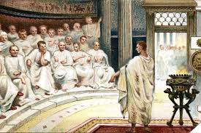
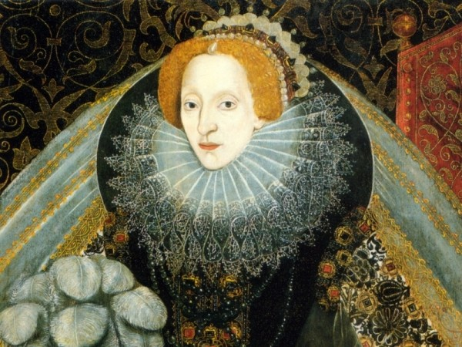
Easy waiver illogical.
Ancient Rome
Long and noble history
Noble purpose
Strong rhetoric
Promote open communications
Essential to legal representation
Strong sense of justice
16th century England

Slide 71
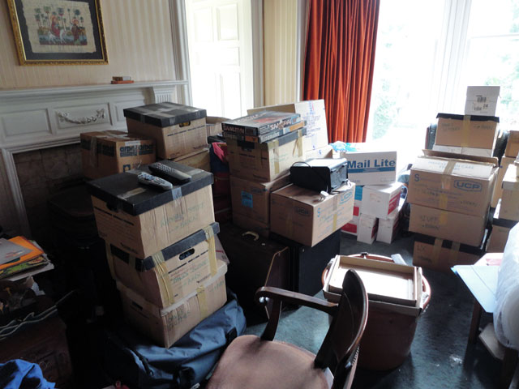
Waiver consequences: Privilege gone.
LOST AND
NOT FOUND
Client forced to disclose testimony or documents
Attorney still cannot generally blab (ethics) except to extent commensurate with waiver

Slide 72
Waiver buffet.
Accidental
Implied
Exceptions (Forced)
Intentional

Slide 73
Accidental Waiver: Easier to lose privilege than car keys
Accidently disclose privileged documents
Unreasonable expectation of privacy
Overbroad distribution and re-distribution
Failure to keep accurate privilege log
No judge sympathy
If a client’s friend or relative is present for attorney-client communications, the communications are not privileged. State v. Rhodes, 627 N.W.2d 74 (Minn. 2001).

Slide 74
Implied waiver: State of Mind
Trouble Brewing:
Tax shelter antitrust willful patent infringement misappropriation of trade secrets security filings internal investigations
Defense:
Advice of counsel
Negligent, not willful
Good faith

Slide 75
Implied waiver: State of Mind
Trouble Brewing:
Tax shelter antitrust willful patent infringement misappropriation of trade secrets security filings internal investigations
Defense:
Advice of counsel
Negligent, not willful
Good faith
Practice tips:
Separate trial and business attorneys
Limit documents that you create
Assert defenses carefully
Recognize deposition risk if witness admits acting on advice of counsel

Slide 76
Privilege Exceptions
Estate disputes
Shareholder suits challenging fiduciary duty
Shareholder derivative suits with “good cause”
Management fraud (Garner doctrine/Garner factors)
Future crime/fraud
Conceal past, current, or future crime/fraud
Attorney can blab
Help me hide the body.

Slide 77
More privilege Exceptions
Common interest among joint clients
Lawyer is necessary witness
??Antitrust violations, copyright infringement, insider trading, etc.???
These are civil and criminal problems.

Slide 78
Federal government is privilege bully.
Congressional hearings
U.S. patriot Act:
No judicial oversight
Monitor prison communications
DOJ expressly punishes asserting privilege
“Willingness to waive privilege is DOJ factor on how doggedly to pursue”
900 Pounds

Slide 79
Can you fix waiver problems?
Corrective action
Preventive action
Corrective tools are difficult to use successfully
© Kontur-vid | Dreamstime.com - Wooden Tool Box Vector Illustration Photo

Slide 80
Corrective action: trying to fix leaky privilege
Accident
Reasonable (best) efforts to avoid
Reasonable (best) efforts to fix
You often must try, but good luck.
© 29mokara | Dreamstime.com - Defective Faucet, Cause Wastage Of Water. Photo

Slide 81
Preventive action: trying to avoid leaky privilege
Accident
Reasonable (best) efforts to avoid
Clawback agreement
Clawback Agreement
If either party accidently discloses a privileged document, the document will be returned and privilege is not waived.
In practice, a better tool unless you have to actually enforce

Slide 82
Special topic: Invention Records
Old law split
Federal Circuit:
Privileged if provided to attorney to secure legal services
Controlled by Federal Circuit law
Implies: overbroad distribution waives privilege
TIP: plan for generating, using, filing, and accessing

Slide 83
Email Notice: Not so good
This e-mail as well as any files transmitted with it may be confidential [of who? Remember agreement obligations.] and may well contain information which is legally privileged. It is intended solely for the use of the individual or the entity to whom it is addressed. If you are not the intended recipient of this e-mail [intended but in error?], you are hereby on notice of this status. Any [missing using] disclosure, copying, distribution, dissemination or publication of the information contained therein is strictly prohibited, unless you have been permitted thereto by the sender, and might be a breach of confidence. If you are not the intended recipient [intended but in error], please return this e-mail immediately to the sender and then delete this message from your system.​

Slide 84
Kaganized Email Notice: Better
This email and any files transmitted with it are ACME Confidential Information and are intended solely for the use of the individual or entity to whom they are addressed. As an intended recipient, you should not disseminate, distribute or copy this e-mail except as expressly authorized by ACME. If you are not the named addressee or you have received this email in error, you should not use, disseminate, distribute or copy this e-mail or any files transmitted with this email. Please notify the sender immediately by e-mail if you have received this e-mail by mistake and delete this e-mail from your system. If you are not the intended recipient or you received this email in error, you are notified that using, disclosing, copying, distributing or taking any action in reliance on the contents of this information is strictly prohibited.

Slide 85
The Magic and Mystery of the Common Interest Agreement
Two different entities
Exchanging legal information
Maintain privilege?
Common interest doctrine
Need agreement
Narrow doctrine

Slide 86
The Magic and Mystery of the Common Interest Agreement
Uh oh.
Yikes.
Waiver of privilege is a big problem if you rely on one of these in the wrong situation.
“Yet, all too often, the privilege is unknowingly waived as a result of lawyers entering into common interest agreements without knowing the scope and enforceability of such agreements under the governing laws of the applicable jurisdiction. Courts throughout the United States vary wildly on the degree to which they enforce common interest agreements, and thus attorneys who do not thoroughly analyze the law governing their agreement risk destroying the privilege and doing so in a drastic fashion: discovery of entire data rooms can be compelled as a result of a poorly researched common interest agreement. Attorneys would be wise to consider their choice of law carefully before entering into such agreements.” The Common Interest Privilege By Matthew D. LaBrie – September 30, 2014

Slide 87
The Magic and Mystery of the Common Interest Agreement
Now you tell me.
Now you’re listening.
Enforceability
Few situations
Choose the right law
Third parties not bound by choice of law
Need the right agreement

Slide 88
The Magic and Mystery of the Common Interest Agreement
We both like the Cubs.
Not good enough.
Joint criminal defense
Joint civil defense or attack
Key: actual or threatened or planned litigation
Joint patent application?
Confidential ≠ Privilege
Less acceptance:
Due diligence
Contract negotiations
Vendor/Supply
Joint research
Regulatory compliance or other LEGAL matters
Not matters that are solely business interests

Slide 89
The Magic and Mystery of the Common Interest Agreement
What does the agreement look like?
Let me show you.
Elements:
Privileged communication
Common interest
Exchange under common interest
No waiver
The fifth element?
Agreement

Slide 90
The Magic and Mystery of the Common Interest Agreement
What does the agreement look like?
Let me show you.
In re Grand Jury Subpoena Duces Tecum, 112 F.3d 910 (8th Cir. 1997).
Recognized the doctrinei n a grand jury proceeding, but rejected Hillary Clinton’s claim to its benefits with respect to privileged communications between Clinton sent to the White House. Whether Mrs. Clinton went to prison was not a cognizable interest of the White House.

Slide 91
Law of Privilege constantly evolves.
Recommended article:
https://www.actl.com/download/file/fid/520

Slide 92
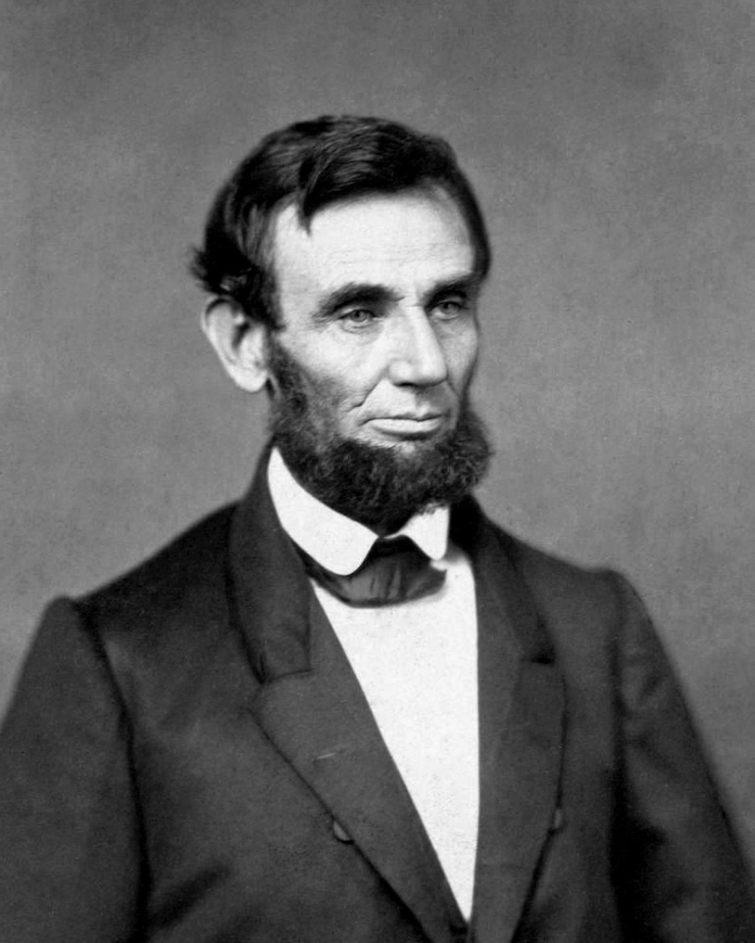
Law of Privilege constantly evolves.
This doesn’t look good for you. My advice, flee the jurisdiction.
Murder trial of Melissa Goings, 1857.
Lincoln is reported to have said, "I did not run her off. She wanted to know where she could get a good drink of water, and I told her there was mighty good water in Tennessee."
Lincoln disclosed privileged communication
Privilege waived?
Today: professional sanctions; disbarment
Ultimate irony: United States saved because 1857 professional ethics more lax.

Slide 93
Thank you.
Boron
B
Potassium
K
Atomic Mass
Neodymium
A
Iodine
Nd
Erbium
Silver
Nitrogen
I
Er
Ag
N
Protons and Neutrons
5
10.811
60
19
144.24
39.098
53
68
47
7
126.90
167.26
107.87
14.007
Intellectual Property Attorneys
All the right elements.

