Slide 1
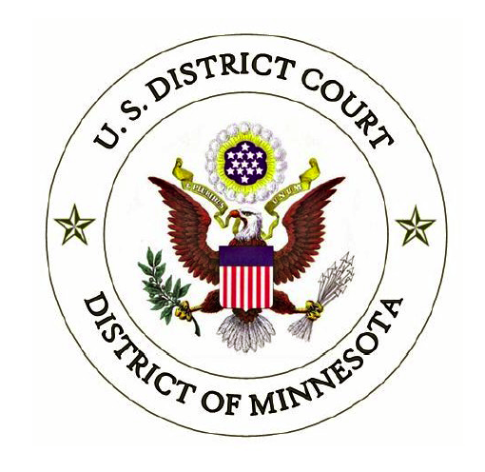
Deposition Comparison:
IPR cross-examinations v. discovery depositions
Honorable Jimmie V. Reyna Intellectual Property Inn of Court
March 17, 2016
‹#›
Notes:
‹#›

Slide 2
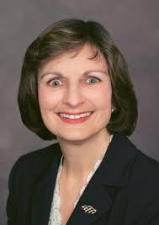
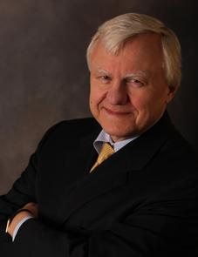
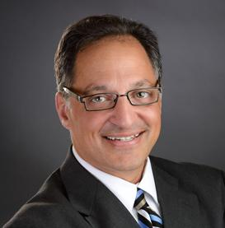
Our panel:
The Honorable Hildy Bowbeer
Magistrate Judge
District of Minnesota
Allen W. Hinderaker
Merchant & Gould
David B. Kagan
Kagan Binder
‹#›

Slide 3
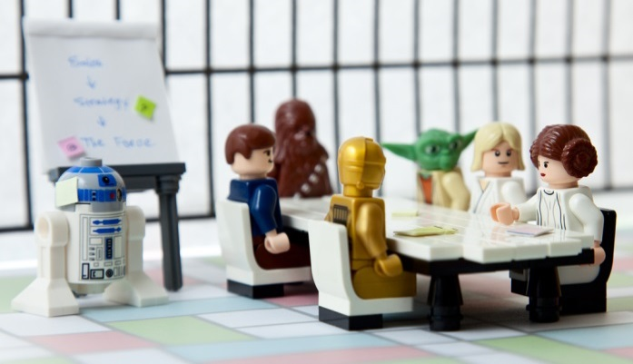
Can you tell which one of these is the IPR deposition?
‹#›

Slide 4
How and why do depositions in IPR proceedings differ from district court patent litigation?
IPR Overview
Purpose
Scope
Process
Preparation
Discovery
Dep
IPR
Dep
Fraternal Twins
‹#›

Slide 5
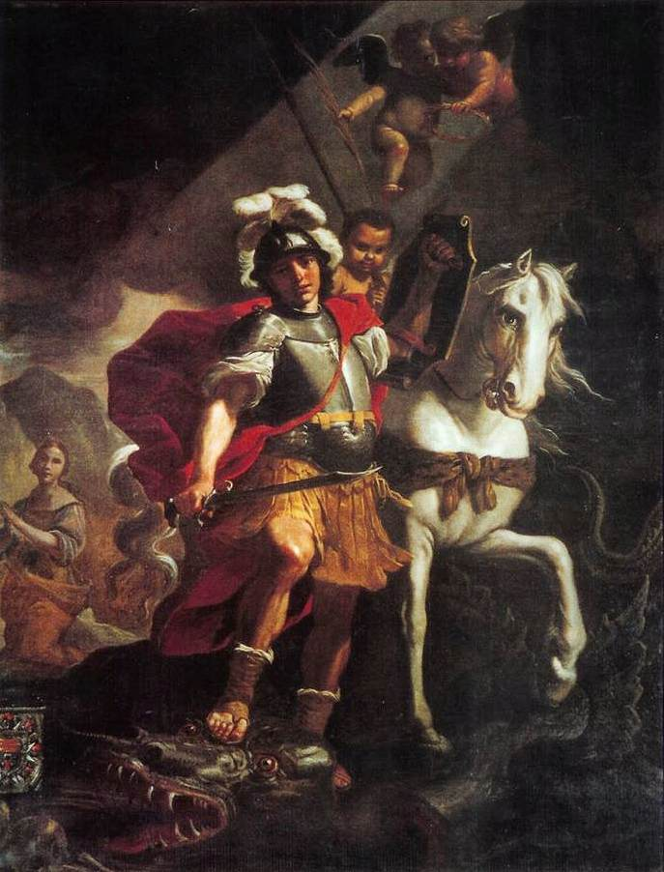
IPR Overview:
Patent challenger (Petitioner) attacks patent
Patent owner defends
PTAB judges (USPTO administrative patent judges) adjudicate
Petitioner getting ready to attack
Patent owner defending
Judge adjudicating
Patent needing to be defended
‹#›

Slide 6
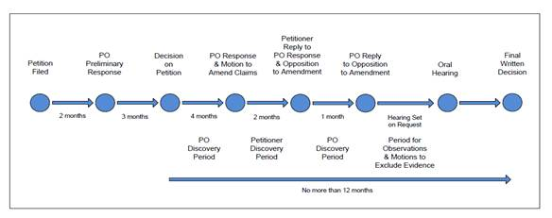
IPR TIMELINE
Evidence briefing occurs here
Every “blue” round of briefing has the same pattern.
Every “blue” round of briefing allows cross examination of direct testimony if PTAB initiates an IPR.
Evidence battles (objections to rulings) occur over a very long period of time. Strange. Strange. Strange.
‹#›

Slide 7
Each round of briefing has a similar pattern.
Let’s use Petitioner’s (patent attacker) petition as an example.
Patent owner files Response.
Cycle repeats.
Patent owner objects to evidence via service, not filing
Patent owner cross examines Petitioner’s witnesses
Petitioner may serve but must not file supplemental evidence
Petition
Testimony
Other Exhibits
Deposition
‹#›

Slide 8
IPR TIMELINE
Evidence briefing occurs here
Evidence briefing occurs here
Likely no crosses by either to the motions to exclude (no new testimony)
Patent owner crosses Petitioner testimony
Petitioner crosses Patent owner testimony
Patent owner crosses Petitioner reply/opposition testimony
Petitioner crosses Patent owner reply testimony
‹#›
Notes:
‹#›

Slide 9
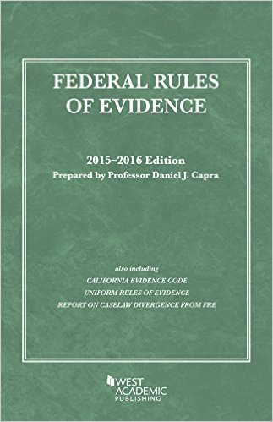
Evidence and Objections
Your main evidence
Patent challenger petition
Patent owner preliminary response
Patent owner response
Patent owner motion to amend
Supplemental evidence
Solely to fix admissibility responsive to objections. May or may not get to file and put on the record.
Supplemental information
Add to your pile of substantive evidence (good luck!)
‹#›

Slide 10
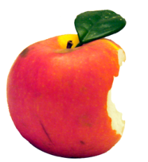
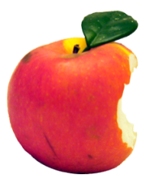
Evidence and Objections
Petitioner gets one bite at the apple
Patent owner gets 2.5 bites at the apple
‹#›

Slide 11
So with that in mind….
How do the purpose, scope, and process for IPR depositions compare with depositions in district court patent litigation?
‹#›

Slide 12
Contrasting Purposes
District Court Deposition
IPR Deposition
Discovery tool used to prepare for dispositive motions and trial
Occurs long before anyone has introduced direct testimony
Judge may never even see the transcript
Cross examination
This is the “trial”
Occurs after other side provides direct testimony (in the form of declarations)
Judge will read and may rely on excerpts
‹#›
‹#›

Slide 13
Contrasting Purposes
District Court Deposition
IPR Deposition
Assess witness credibility for trial
Create inconsistent statements to use at trial
Gather helpful admissions
Learn facts
Narrow issues for trial
Obtain settlement leverage
Preserve testimony (in case witness doesn’t come to trial)
‹#›
‹#›

Slide 14
Contrasting Purposes
District Court Deposition
IPR Deposition
Assess witness credibility for trial
Create inconsistent statements to use at trial
Gather helpful admissions
Learn facts
Narrow issues for trial
Obtain settlement leverage
Preserve testimony (in case witness doesn’t come to trial)
Assess witness credibility for your next brief
Create inconsistent statements to use at trial in your next brief/observations
Gather helpful admissions
Learn facts
Narrow issues for trial
Obtain settlement leverage
Preserve testimony
‹#›
‹#›

Slide 15
Contrasting Scope
Rule 26(b)(1)
District Court Deposition
(b) Discovery Scope and Limits.
(1) Scope in General. Unless otherwise limited by court order, the scope of discovery is as follows: parties may obtain discovery regarding any non-privileged matter that is relevant to any party’s claim or defense and proportional to the needs of the case, . . .
Novelty
Nonobviousness
Sales
Inventorship
Admissible or inadmissible
Agreements
Misuse
Indefinite
Written Description
Rule 26(a)(2)(B)
Expert report must be “complete statement of all opinions the witness will express.”
Far-ranging
‹#›
‹#›

Slide 16
Contrasting Scope
37 C.F.R. 42.224(b)
IPR Deposition
(b) Discovery is limited to evidence directly related to factual assertions advanced by either party in the proceeding.
And, the scope of a deposition is limited to the scope of the declaration on which that witness is being cross-examined – i.e., the witness’s direct testimony. 37 C.F. R. 42.53(d)(5)(ii).
Restricted
‹#›
‹#›

Slide 17
Scope Limitations in Action
Can defending counsel instruct a witness not to answer a question on the ground that it is irrelevant or outside the scope (of the proceedings or the direct testimony)?
‹#›
‹#›

Slide 18
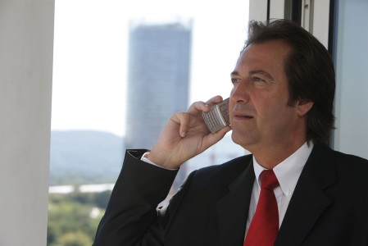
First, an important process difference between district court and IPR depositions:
APJs are very active deposition managers . . .
And they like that!
I order the witness to answer the questions.
Federal district court (and magistrate) judges aren’t . . . And don’t want to be!
‹#›

Slide 19
Scope Limitations in Action
Can defending counsel instruct witness not to answer question on relevance or scope grounds?
Rule 30(c)(2) Objections
(2) Objections. An objection at the time of the examination . . . A person may instruct a deponent not to answer only when necessary to preserve a privilege , to enforce a limitation ordered by the court, or to present a motion under Rule 30(d)(3).
Generally not.
Discovery Deposition
‹#›
‹#›

Slide 20
Scope Limitations in Action
Can defending counsel instruct witness not to answer question on relevance or scope grounds?
IPR Deposition
Appendix D Testimony Guidelines
4. Counsel may instruct a witness not to answer only when necessary to preserve a privilege, to enforce a limitation ordered by the Board, or to present a motion to terminate or limit the testimony.
There’s a good argument to be made...
37 C.F.R. 42.108 (b) Instruction
(b) At any time prior to institution of inter partes review, the Board may deny some or all grounds for unpatentability for some or all of the challenged claims. Denial of a ground is a Board decision not to institute inter partes review on that ground.
‹#›
‹#›

Slide 21
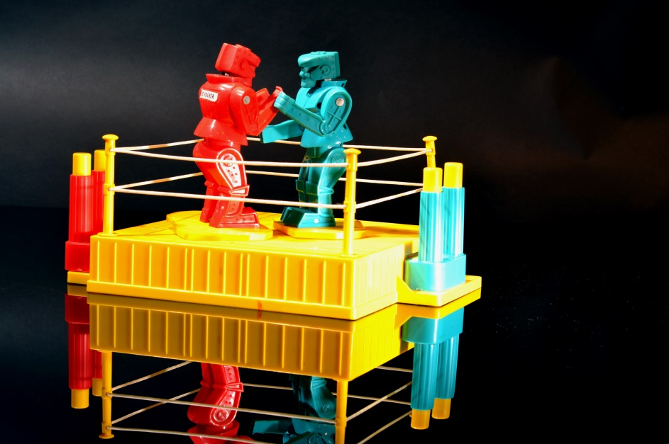
Scope Limitations in Action
Tension in IPR depositions:
On the one hand, scope of cross is limited to scope of direct testimony, and arguably should be limited to the scope of the issues as instituted.
On the other, APJs tend to believe that, with few exceptions, defending counsel must only object, and cannot instruct witness not to answer a question.
‹#›
‹#›

Slide 22
Instructions Not to Answer in IPR:
Always appropriate to protect privilege.
May be appropriate to limit scope per prior PTAB order limiting the grounds for institution (e.g., IPR2013-00424, novelty v. inventive step)
But, unwarranted instruction not to answer risks sanctions, exclusion of testimony, re-producing witness, award of fees/expenses. See IPR2104-000111 and IPR2013-00131
Therefore, consider calling the judge and asking for ruling on the spot.
If no call to judge, defending counsel objects to the out of scope question/testimony and, if desired, later files a motion to exclude the out of scope testimony (IPR2013-131)
Practice Tip: Have the APJ phone number with you at the deposition so instructions not to answer can be challenged.
‹#›
‹#›

Slide 23
Objection procedure
IPR Evidence battles occur over a very long period of time and may never get resolved.
If not timely, objections are waived.
IPR Timeline
Brief with evidence filed
Motions to exclude phase
Objections served or made at cross
Final hearing
Pattern repeats
Final decision
Supplemental evidence served
‹#›

Slide 24
Objection Strategies at the IPR Deposition Taking the deposition
Rule 42.64: Objection: motion to exclude: motion in limine
(a) Deposition evidence. An objection to the admissibility of deposition evidence must be made during the deposition. Evidence to cure the objection must be provided during the deposition, unless the parties to the deposition stipulate otherwise on the deposition record.
‹#›

Slide 25
Objection Strategies at the IPR Deposition Taking the deposition
Stick with the default rule: require defending counsel to make objections in real time on the record or waive the objections.
Advantages: (1) you get notice and opportunity to fix problems in the deposition, since there won’t be a second chance later; (2) maybe opposing counsel will overlook an objection.
Disadvantages: No objections 🡪 no opportunity for opposing counsel to protect witness?
‹#›

Slide 26
Objection Strategies at the IPR Deposition Defending the deposition
Consider whether to agree to reserve objections* until later.
Advantages: (1) Gives you time with the transcript to consider your objections; (2) Doesn’t put the questioner on notice to fix problems.
Disadvantages: (1) Possible missed opportunities to limit scope of testimony or alert witness to problems with questions; (2) If you’re not listening for possible objections, are you really listening?
Unless needed to preserve an important objection, think twice about objections that tell questioner how to improve the cross.
Protect privilege.
Consider opportunities to limit scope.
*Except privilege!
‹#›

Slide 27
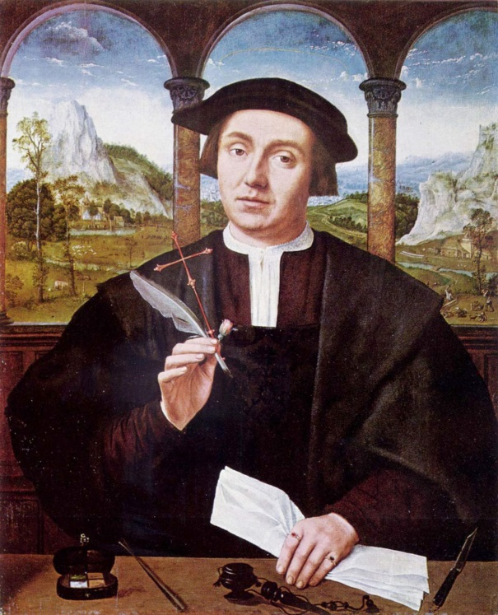
BTW: In both IPR and District Court depositions, coaching is verboten
IPR trial guidelines proscribe witness coaching.
I strenuously OBJECT on the grounds that the question is VAGUE AND INDEFINITE, but I’ll allow the witness to answer if, after pausing to think over her answer and re-read the patent from beginning to end, particularly focusing on column 3, lines 20-27, she responds that, in fact, boiling the solvent without first washing the reactor flask is ENTIRELY PROPER and in no way undermines the quality of the captured vapors.
‹#›
‹#›

Slide 28
IPR Deposition Preparation
Preparing to take the deposition
Preparing to defend the deposition
Preparing the witness
Absolutely crucial
Best argument/evidence in world may be ruined if witness is not properly prepared
But, opposing counsel can conduct a poor cross examination and still win
Most intellectually challenging part of the IPR proceeding.
‹#›
‹#›

Slide 29
Preparing to take an IPR deposition
Basic principles
Analyze opponent’s brief and evidence that was just filed.
Analyze sample cross exams via IPR portal resources
Develop an outline of your opposition/reply brief (theme, policy, equity, facts, law, learn your judges’ evidence recipes)
Plan the evidence needed for your brief
Plan your attacks on the witness, e.g.:
Undermine facts
Establish facts
Lay groundwork to exclude evidence (e.g., lack of first-hand knowledge, hearsay)
Think about how you’ll make the written record as to visual or non-verbal evidence
Prepare cross-exam strategies/outline/plan
Advise court reporter of tighter deadlines than is conventional
‹#›
‹#›
Notes:
Note that IPR depos aren’t videotaped, so need to remember to capture non-verbal communication (e.g. pointing, drawing, gesturing) for the written record.
‹#›

Slide 30
Preparing to take an IPR deposition
Resources to have with you at the deposition
Exhibit books
Reserved exhibits
Developed exhibits
“Trial” notebook/cross outline
USPTO Phone numbers (judge to resolve disputes)
‹#›
‹#›

Slide 31
Preparing to defend an IPR deposition
Basic principles
Preparing the witness for cross begins when you start working on his or her declaration (i.e., the direct testimony)
Review witness’s prior testimony or writings before engaging the witness, and again while preparing the direct testimony
Prepare yourself and the witness on the issues and facts and predicted attack strategies used by opponent
Instruct witness early and often about how to protect privilege
Carefully pick the documents you will use for preparation – assume they will be discoverable
Allow plenty of time for witness prep
Plan for re-direct
‹#›
‹#›

Slide 32
Preparing to defend an IPR deposition
Starting with preparation of the declaration
Direct testimony should be carefully crafted
Witness should be comfortable “owning” each statement
Have a plan in advance for laying foundation and establishing admissibility of the direct testimony.
Each statement should be based on first-hand knowledge or be otherwise admissible
APJ’s love to read the backstory of your witness, so include it.
You know the cross is coming, so test each statement with your own cross-exam to make sure each is accurate and defensible
Start now to lay the foundation with your witness about how to behave during deposition – while the deposition is far off and jitters haven’t yet set in
‹#›
‹#›

Slide 33
Preparing to defend an IPR deposition
Preparing for opposing counsel’s cross
Identify the issues and facts to defend
Anticipate how your opponent is likely to attack
TIP: Use prior cross exams on IPR web portal as a resource
Gather documents to use for preparation (direct testimony, cited exhibits)
Finalize your preparation plan
how to defend the facts and issues
how to behave at the deposition
how to protect privilege
Allow 1-3 days for witness prep, ideally with 1-2 days between prep and deposition so witness will be rested but prep will still be fresh
Anticipate the cross on key issues and plan your re-direct – this is the trial, so you can’t “save it for later”
‹#›
‹#›
Notes:
Discussion note – IPR depos are rarely if ever videotaped, so prepping the witness to be an effective on-camera presenter is generally not an issue.
‹#›

Slide 34
Some IPR Deposition Takeaways
An IPR deposition is essentially a trial cross examination – taken after the other side has filed its direct testimony via declarations.
An IPR deposition is taken live, but presented to the judge in transcript form – plan accordingly.
THIS IS THE TRIAL – so you can’t save objections, more devastating cross, re-direct, or re-cross for some future more opportune moment.
Plan for the cross examination as you prepare the direct testimony (i.e., declaration). The best briefing in the world is for naught if your witness goes down in flames when cross-examined.
As in any adversarial proceeding, thorough preparation is key.
IPR database is a priceless preparation tool.
‹#›

Slide 35
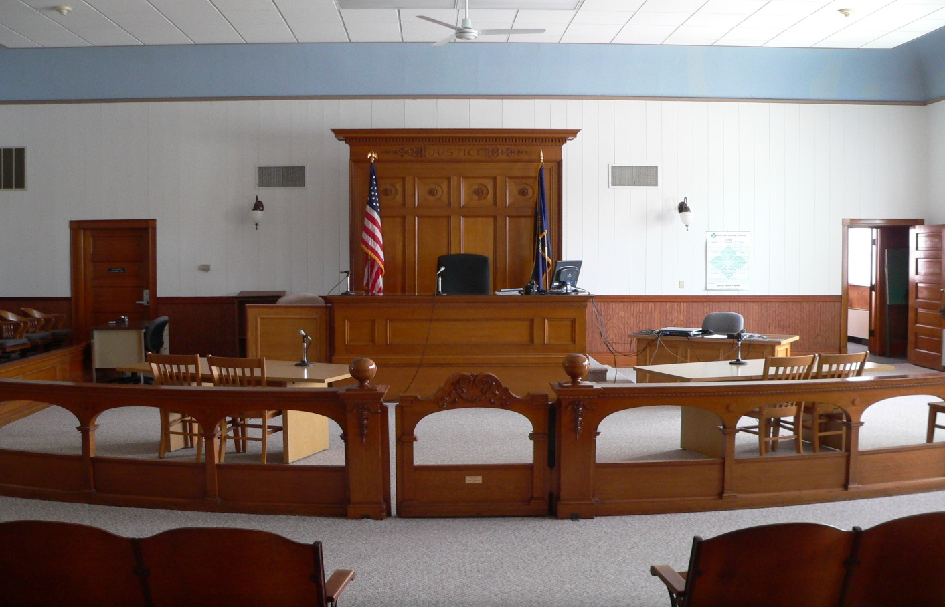
Thank you from your panel members!
‹#›

