Slide 1
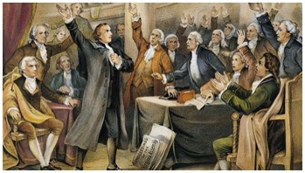
Snapshot 1: Four Major Stars in Every License Agreement
Title
How the Big Four can help you draft and negotiate any license agreement
David B. Kagan
Kagan Binder, PLLC
Stillwater, Minnesota
Presented to MNCLE
January 31, 2020
Snapshot!
Agreement Wisdom in a Flash!

Slide 2
Four Major Stars of Every Agreement
Licensed Product
Licensed IP
Grant
Payments

Slide 3
Start with the Big Four
License Product..Licensed Patent..Grant..Payments
Better match between business model and agreement
Easier drafting
Less expensive process
Negotiation tool
Ex parte analysis tool
Marketing tool
The Big Four provide a foundation for a better deal.

Slide 4
Start with the Licensed Product
Definition choice impacts agreement architecture more than any other clause.
Bold Statement?
Yes, but true.

Slide 5
Definition of Licensed Product has huge impact on how burdens, rights, and risks are allocated
Turnkey definition
Licensor supplies finished product(s), equipment, process
Licensor controls design(s)
Supply-license hybrid
Claim scope definition
Supplying concepts, not things
Licensee controls the design
Classic patent/know how license

Slide 6
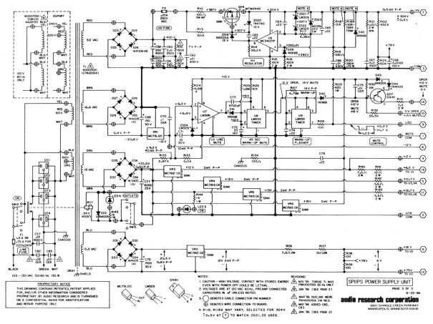
Definition of Licensed Product impacts Agreement Architecture big time
Turnkey license is more complex
Classic license is less complex
A
B
C
Choose definition approach early.

Slide 7
Licensed Technology IP
Patents
Know How
Trade secrets
Show how
aka Technical Assistance

Slide 8
Three Main Kinds of License Grants
Nonexclusive
Exclusive
Sole
Statutory rights that you can control or access via patent license:
MAKE USE SELL OFFER TO SELL IMPORT
Making, having made, making for others

Slide 9
Payments
Intuitive: plan for things going wrong
Counterintuitive: plan for too much success
Too much success catalyzes disputes

Slide 10
Take this idea home with you
Start here:
Licensed product
Licensed IP
Grants
Payments

