Slide 1
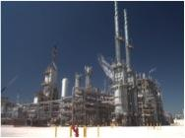
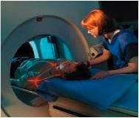
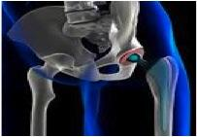
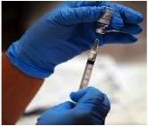
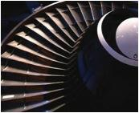
Freedom to Operate (FTO)
Primary goal
Patent claims define your risk
Patent claims are hard to understand
Willful infringement
FTO options
© 2015 Kagan Binder, PLLC

Slide 2
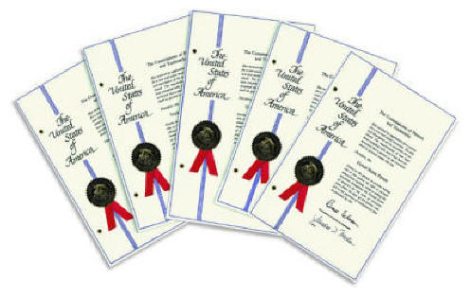
FTO Goal: Avoid infringing valid, enforceable patent rights of third parties
Show non-infringement (design around)
Show claims are invalid
??Show claims are unenforceable
Expressly or impliedly license/acquire rights
Ineligible
Exhaustion
Misuse
Ownership/derivation
Avoid willful infringement

Slide 3
Patent Claims define your infringement risk.
US Patent No. 9,999,999
A, B, C, D, E ,F, G, A1, A2, A3, A4
B1, B2, B3
What is claimed is:
1. A solar tower comprising A and B.

Slide 4
Patent Claims define your infringement risk.
US Patent No. 9,999,999
A, B, C, D, E ,F, G, A1, A2, A3, A4
B1, B2, B3
What is claimed is:
1. A solar tower comprising A and B.
Basic rule: Claim infringed if every claim element is found in the accused process, machine, article of manufacture, or composition.
Corollary: Infringement can occur literally or under the doctrine of equivalents.

Slide 5
Patent Claims define your infringement risk.
What is claimed is:
1. A solar tower comprising A and B.
A
B
Infringement: Every claim element is in the accused device.

Slide 6
Patent Claims define your infringement risk.
What is claimed is:
1. A solar tower comprising A and B.
A
C
No Infringement: Accused device missing B.

Slide 7
Patent Claims define your infringement risk.
What is claimed is:
1. A solar tower comprising A and B.
A
C
B
C
D

Slide 8
Infringement and Patentability are opposites
What is claimed is:
A,
B, and
E
Invention Record
A,
B, and
G
A
C
B
C
D
No infringement because E is missing.
Patentable because G is missing.

Slide 9
Infringement and Patentability are opposites
What is claimed is:
A,
B, and
C
Invention Record
A,
B, and
D
A
C
B
C
D
Infringement. Irrelevant that D is present.
Unpatentable. Irrelevant that prior art has C.

Slide 10
Patent claims are narrower, the same, or broader than what they say.
-
0
+
Narrower
Broader
Claim Scope Meter

Slide 11
Literal Claim Construction: A claim means what it says
What is claimed is:
1. A solar tower comprising A and B.
A
A
A
B
B
C
3
C
A
2
4
1

Slide 12
Doctrine of equivalents: A claim is broader than what it says
What is claimed is:
1. A solar tower comprising A and B.
A
C
IS C an equivalent of B?

Slide 13
Doctrine of equivalents: A claim is broader than what it says
What is claimed is:
1. A solar tower comprising A and B.
Whether the difference between the feature in the accused device and the limitation literally recited in the patent claim is "insubstantial."
Warner-Jenkinson Co. v. Hilton Davis Chem. Co. (S.Ct. 1997)
A
IS C an equivalent of B?
C

Slide 14
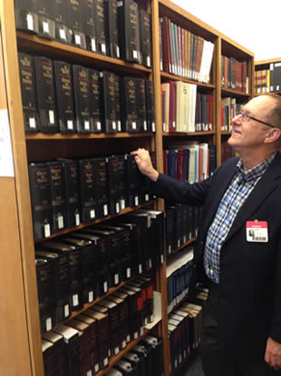
Doctrine of equivalents: A claim is broader than what it says
What is claimed is:
1. A solar tower comprising A and B.
4 Shelves!!!
A
C
IS C an equivalent of B?

Slide 15
Fortunately, legal theories are available to limit the doctrine of equivalents.
What is claimed is:
1. A solar tower comprising A and B.
Prosecution history estoppel
Hypothetical claim doctrine
Function way result
Negative teaching
Disclaimer
Disclosed but not claimed
All elements rule
A
C
IS C an equivalent of B?

Slide 16
Disclaimer: A claim is narrower than what it says
What is claimed is:
1. A solar tower comprising A and B.
A
B really means only b1 and no other B.
B
No protection for b2, b3, b4, etc.

Slide 17
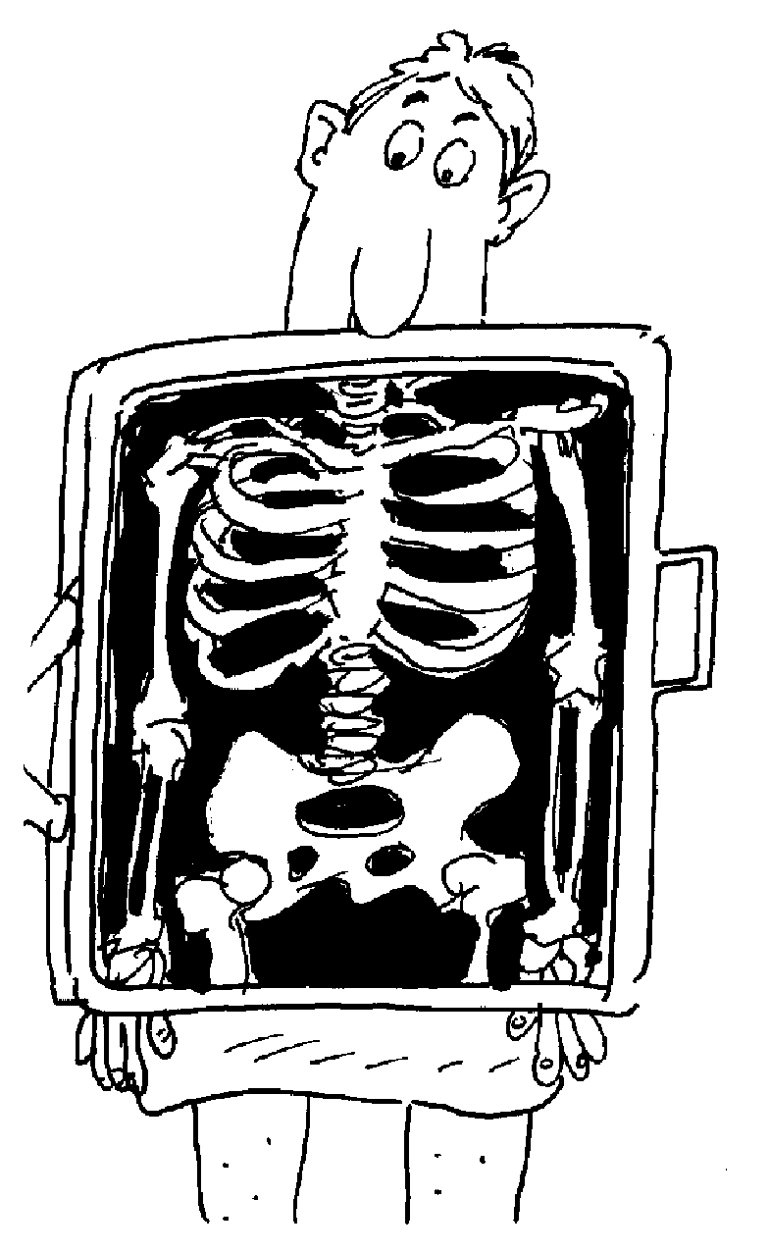
Disclaimer: A claim is narrower than what it says
Cause of “Placebo” Claim:
Patentability arguments filed with USPTO fail to match claim scope
Significant trend

Slide 18
Disclaimer: A claim is narrower than what it says
Viskase Corp. v. Amer. National Can Co.
About 0.91?
Precisely 0.910

Slide 19
Disclaimer: A claim is narrower than what it says
Day Intl. Inc. v. Reeves Bros. Inc.
Below the melting point?
Below the melting point and in the range 110°F to 170°F.

Slide 20
Disclaimer: A claim is narrower than what it says
Tegal Corp. v. Tokyo Elect. Amer. Inc.
Plasma?
Only glow discharge plasma and no other plasmas.

Slide 21
Disclaimer: A claim is narrower than what it says
Rheox Inc. v. Entact Inc.
Calcium orthophosphate but not TSP and not monocalcium orthophosphate.
Calcium orthophosphate?

Slide 22
Disclaimer: A claim is narrower than what it says
Scimed Life Systems v. Advanced Cardiovascular Systems
Dual lumen?
Afraid not. Only co-axial.

Slide 23
Disclaimer: A claim is narrower than what it says
Kopykake Enterprises v. The Lucks Co.
Printing?
Sorry, not ink jet printing.

Slide 24
Patent claims are narrower, the same, or broader than what they say.
-
0
+
?
?
?
?
?
Narrower
Broader
Claim Scope Meter
Figuring out what claims mean is most important part of patent law, but is NOT intuitive!

Slide 25
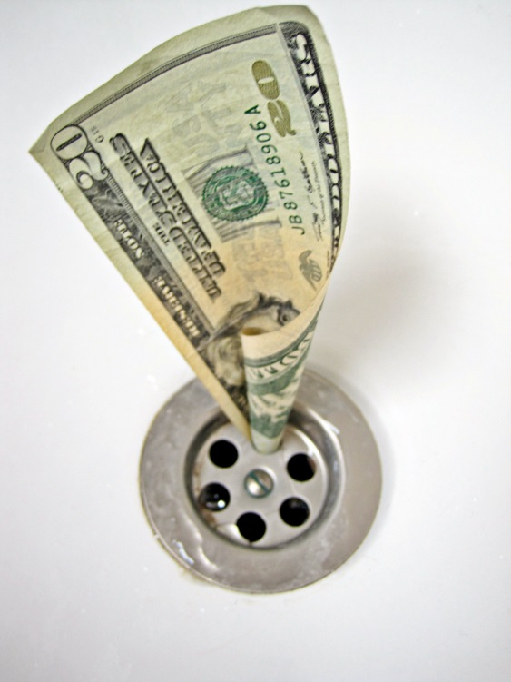
You should avoid willful infringement
Know about a patent, but infringe anyway
Inadequate actions to avoid infringement
“Objectively reckless”
Treble Damages
Attorney Fees

Slide 26
Treble damages and attorney fees are scary.
Asserted in 90% of cases
Damages: $10’s and $100’s of millions
Attorney fees: $1 to $5 million and more

Slide 27
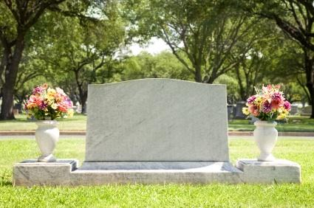
History is important to understand willful infringement
Federal Circuit: 1982 - present
Underwater Devices (1983)
Affirmative duty to avoid infringement (due care)
Competent legal opinion satisfies duty
Seagate (2007) overrules
R.I.P.
Underwater Devices
1983 - 2007

Slide 28
What does competent legal opinion say?
No infringement
Invalid
Unenforceable (rare)
License (express or implied)
Exhaustion
Ineligible subject matter
Misuse
Wrong inventorship/ownership
Ultimate conclusion: No infringement of a valid, enforceable patent claim.

Slide 29
In re Seagate (2007) announces a new rule for willful infringement
Infringement
“Objectively high likelihood” of infringing a valid claim
Infringer knew the risk.
Opinion no longer essential
Intent
If opinion no longer essential, what do you do?

Slide 30
Clearly, opinion not essential.
No opinion, but still no willful infringement in Eastman Kodak (SDNY 2007):
Bona fide design around work
Patent agents helped
Patent owner waited 6 years to act
No opinion, but still no willful infringement in Honeywell (D. Del. 2008):

Slide 31
Clearly, opinion not essential.
No opinion, but still no willful infringement in Eastman Kodak (SDNY 2007):
Bona fide design around work
Patent agents helped
Patent owner waited 6 years
SWIM AT YOUR OWN RISK
No opinion, but still no willful infringement in Honeywell (D. Del. 2008):
Very risky strategy.

Slide 32
Opinions of counsel are still part of the best strategy
Written opinion showed infringement not willful:
Lexicon Medical (Fed. Cir. 2008)
Cohesive Tech. (Fed. Cir. 2008)
Two early examples. Many more since.
17

Slide 33
Is a written opinion all you need?
Opinion never provided to management. Chiron (E.D. Cal. 2002)
3 opinions not relied on, not competent, and not timely. Applied Medical Resources (Fed. Cir. 2006)
Outside counsel wrote, but inside counsel edited the opinion parts. Eli Lilly (S.D. Ind. 2001)
Clearly, merely having an opinion on hand is not a good defense
17

Slide 34
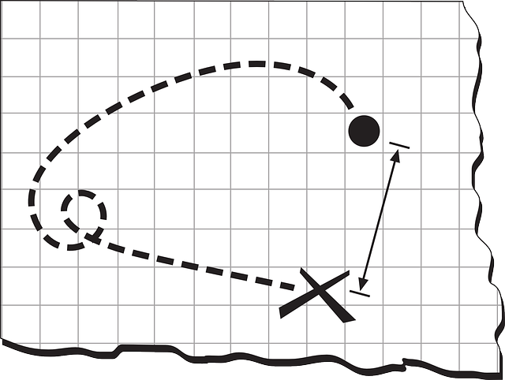
Plan to avoid willful infringement
Set up team.
Communication plan (privilege)
Assess infringement risk of valid, enforceable claims
Potential design around work
Timely written opinion
Communicated to management
Relied upon by management
Document actions

Slide 35
The root of all ownership problems in the patent world is the ownership statute.
35 USC 262. Joint owners.
In the absence of any agreement to the contrary, each of the joint owners of a patent may make, use, offer to sell, or sell the patented invention within the United States, or import the patented invention into the United States, without the consent of and without accounting to the other owner.
Most litigated issue in joint research disputes.

Slide 36
Statutory Battles
35 USC 262. Joint owners.
Joint owners can act independently.
Unless there is an “agreement to the contrary.”
Joint development agreements
“A2C”
Employee agreements
Consultant agreements
NOT nondisclosure agreements

Slide 37
Joint owners can act independently
Ethicon took a cheap license from a second joint owner to avoid $$$$ infringement action brought by the first owner.
Ethicon Inc. v. United States Surgical Corp. 45 USPQ2d 1545 (Fed. Cir. 1998).
Without A2C, jointly owned patent is very much less valuable.

Slide 38
Is there an A2C?
Joint owner wants to act independently (bad deal)
Under French law, A2C exists (Joint owner bound).
Under US law, no A2C (Joint owner independent)
French law governed ownership of US patent!
Even though US law authorizes A2C, agreement interpreted per agreement.
International Nutrition Co. v. Horphag Research Ltd., 59 USPQ2d 1532 (Fed. Cir. 2001).

Slide 39
Is there an A2C?
The parties tried to negotiate an agreement, but negotiations failed. No agreement was signed ever. Is Joint Owner free to act independently?
A promise to negotiate is an A2C under unjust enrichment theory.
Massachusetts Eye and Ear Infirmary v. QLT Phototherapeutics Inc., 75 USPQ2d 1225 (1st Cir. 2005).
Written. Oral. Implied. Conduct. Promise to promise

Slide 40
Who is bound?
Only joint owners who are parties to an A2C are bound.
Inventors A and B signed agreement and filed patent application.
New claims added after filing. New Joint Inventor C.
New inventor C not bound by earlier A2C!
Massachusetts Eye and Ear Infirmary v. QLT Phototherapeuitics Inc., 75 USPQ2d 1225 (1st Cir. 2005).
Awesome litigation opportunity, particularly when used with Ethicon!

Slide 41
What happens if Joint Owner breaches an A2C?
Breaching Joint Owner forfeited the right to use the patent!
Wisconsin Alumni Research Foundation v. Xenon Pharmaceuticals Inc., 93 USPQ2d 1361 (7th Cir. 2010).

Slide 42
Can Joint Development Agreement govern technology developed outside the JDA?
YES!
Patent application includes
Joint research claims claims
Other claims clearly outside the joint research.
JDA applies to the WHOLE patent.
Lucent Technologies Inc. v. Gateway Inc., 88 USPQ2d 1481 (Fed. Cir. 2008).

Slide 43
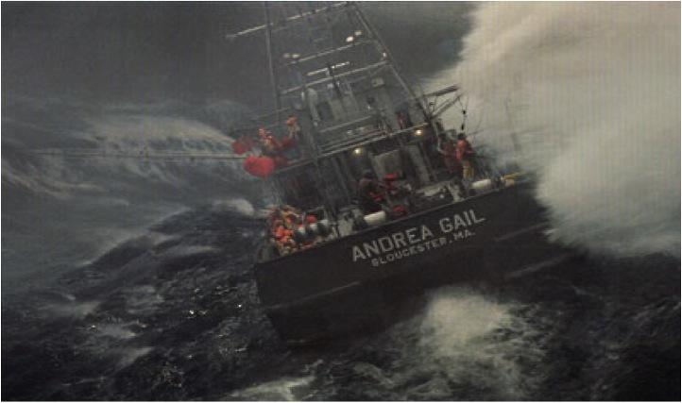
Safe Harbor
Perfect Storm
The Patently
Before 2004, confidential information of Party A is prior art against Party B
Makes it really hard to patent fruits of joint research.

Slide 44
Safe Harbor
Perfect Storm
The Patently
You can avoid confidential prior art of the other Party using the safe harbor of a Joint Research Agreement (JRA).
I could use a safe harbor right now
Hopefully it’s the NEW safe harbor and not the old one.

Slide 45
OLD JRA Safe Harbor
CREATE Act Safe Harbor (Pre-AIA):
Prior art belongs to a JRA party.
Written JRA before claimed invention made.
Claimed invention made under JRA.
Patent application discloses JRA parties.
Only obviousness rejections for 102(e)(f)(g) prior art
Not always realistic
Silly!
Hardly useful at all.

Slide 46
NEW JRA Safe Harbor
Prior art belongs to a JRA party.
Written JRA before effective filing date.
Claimed invention made under JRA.
Patent application discloses JRA parties.
Any novelty or obviousness rejections over patent or application filed before but published or issued after effective filing date.
Much better!

Slide 47
Thank you.
Boron
B
Potassium
K
Atomic Mass
Neodymium
A
Iodine
Nd
Erbium
Silver
Nitrogen
I
Er
Ag
N
Protons and Neutrons
5
10.811
60
19
144.24
39.098
53
68
47
7
126.90
167.26
107.87
14.007
Intellectual Property Attorneys
All the right elements.

