Slide 1
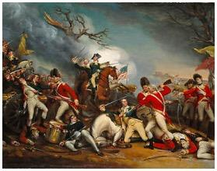
Snapshot 2: Patent License v. Covenant not to Sue
Title
What’s the difference?
David B. Kagan
Kagan Binder, PLLC
Stillwater, Minnesota
Presented to MNCLE
January 31, 2020
Snapshot!
Agreement Wisdom in a Flash!

Slide 2
COVENANT NOT TO SUE
CN2S**
** Abbreviation is a Kaganization

Slide 3
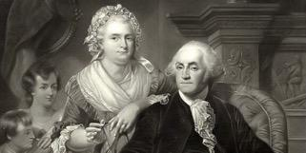
Reasonable expectation: CN2S and a patent license are different
You say potato, I say po-tah-to.
We’re so different. Let’s call the whole thing off!
Patent license: property transfer
Covenant not to sue: contract obligation

Slide 4
Reasonable expectation: Practical consequences
Bankruptcy: Only patent licensee protected under Section 11 USC 365(n)
Exhaustion: Only patent license triggers
Joint owners: Only patent license binds other joint owners

Slide 5
You expect differences, but courts say they are the same
1927
DE FOREST RADIO TELEPHONE & TELEGRAPH CO. v. U.S., 273 U.S. 236 (1927)
Transcore v.Electronic Transaction, 563 F.3d 1271 (Fed. Cir. 2009)
Innovus Prime, LLC v. Panasonic Corp., Case No. C-12-00660-RMW (N.D. Cal. Jul. 2, 2013)
2007
2013
CN2S = Nonexclusive license

Slide 6
The sameness has legal consequences
CN2S triggers patent exhaustion
Transcore (Fed. Cir. 2009)
Even an offer of a CN2S triggers exhaustion!
Alberta Telecomm. Res. Centre v. AT&T Corp., 3-09-cv-03883 (NJD July 14, 2014, Order) (Sheridan, J.);
Covenant not to sue protected in bankruptcy under 11 USC 365(n)
In re Spansion, Case Nos. 11-3323, -3324 (3rd Cir., Dec. 21, 2012) (Scirica, J.).
Expect other patent joint owners to be bound by CN2S**
See General Mills, Inc. v. Kraft Foods Global, Inc., 495 F.3d 1378 (Fed. Cir. 2007); Transcore (Fed. Cir. 2009); Ethicon Inc. v. United States Surgical Corp., 45 USPQ2d 1545 (Fed. Cir. 1998)
** Kaganization

Slide 7
But do differences presently exist?
Patent owner can impose CN2S unilaterally to end litigation (moots case or controversy)**
Mere offer of CN2S to end litigation triggers patent exhaustion**
** Kaganization: These are not real differences

Slide 8
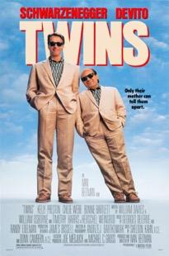
Yes, CN2S and patent license are twins.

