Slide 1
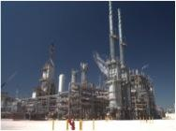
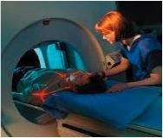
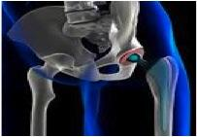
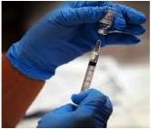
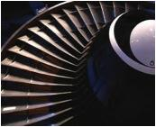
Patents are different from other IP
Unique characteristics
Good and bad
Valuable
Why have a patent system?
© 2015 Kagan Binder, PLLC

Slide 2
In addition to patents, what other IP choices are there?
True or False: There are 4 types of intellectual property:
Patents
Trademarks
Trade secrets
Copyrights
True
False

Slide 3
In addition to patents, what other IP choices are there?
True or False: There are 4 types of intellectual property:
Patents
Trademarks
Trade secrets
Copyrights
Mask works and plant varieties
Know how
Contracts
Employees
Suppliers
Customers
Products/Services
Manufacturing prowess
True
False
18

Slide 4
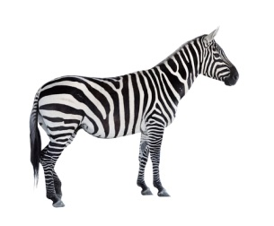
Why are patents different?
Patents
Trademark
Copyright
Trade secret
Timing
Lifespan
Respect
Law
Expense to procure
Know How
Contracts
Other
© Vladvitek© Vladvitek | Dreamstime.com© Vladvitek | Dreamstime.com - The Zebra. Photo
© Sunlight789© Sunlight789 | Dreamstime.com© Sunlight789 | Dreamstime.com - Funny Zebra Cartoon Photo

Slide 5
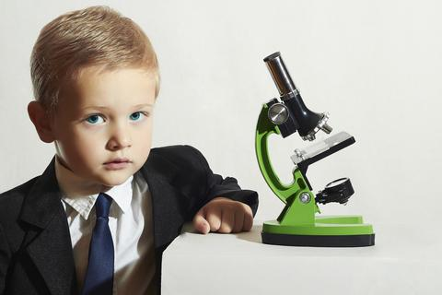
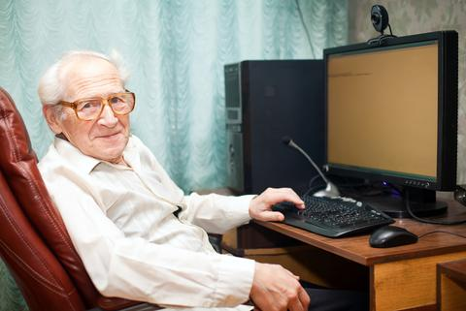
Patents take years to place.
Even after you make an invention, patent rights do not exist until years later when all of the following have occurred:
Prepare application
File application
Prosecute application
Issue application
Inventor
Patentee
Trademarks, trade secrets, copyrights are instant.
© Eugenepartyzan© Eugenepartyzan | Dreamstime.com© Eugenepartyzan | Dreamstime.com - Little Boy In Tie. Child.children.Schoolboy Working With A Microscope.Smart Boy Photo
© Anitabonita© Anitabonita | Dreamstime.com© Anitabonita | Dreamstime.com - Pleased Old Man Near Computer Photo

Slide 6
Patents take years to place.
Even after you make an invention, patent rights do not exist until years later when all of the following have occurred:
Prepare application
File application
Prosecute application
Issue application
Presentation filled with KAGANISTICTM wisdom.
Inventor
Patentee
Trademarks, trade secrets, copyrights are instant.
© Eugenepartyzan© Eugenepartyzan | Dreamstime.com© Eugenepartyzan | Dreamstime.com - Little Boy In Tie. Child.children.Schoolboy Working With A Microscope.Smart Boy Photo
© Anitabonita© Anitabonita | Dreamstime.com© Anitabonita | Dreamstime.com - Pleased Old Man Near Computer Photo

Slide 7
Patents take years to place.
Even after you make an invention, patent rights do not exist until years later when all of the following have occurred:
Prepare application
File application
Prosecute application
Issue application
Roses are red, violets are purple.
I’m using molten salt to do something thermal.
Inventor
Patentee
Inventor
Patentee
© 2015 Kagan Binder, PLLC
Trademarks, trade secrets, copyrights are instant.
© Eugenepartyzan© Eugenepartyzan | Dreamstime.com© Eugenepartyzan | Dreamstime.com - Little Boy In Tie. Child.children.Schoolboy Working With A Microscope.Smart Boy Photo
© Anitabonita© Anitabonita | Dreamstime.com© Anitabonita | Dreamstime.com - Pleased Old Man Near Computer Photo

Slide 8
Patents take years to place.
Even after you make an invention, patent rights do not exist until years later when all of the following have occurred:
HUGE DRAWBACK
Prepare application
File application
Prosecute application
Issue application
Inventor
Patentee
Trademarks, trade secrets, copyrights are instant.
© Eugenepartyzan© Eugenepartyzan | Dreamstime.com© Eugenepartyzan | Dreamstime.com - Little Boy In Tie. Child.children.Schoolboy Working With A Microscope.Smart Boy Photo
© Anitabonita© Anitabonita | Dreamstime.com© Anitabonita | Dreamstime.com - Pleased Old Man Near Computer Photo

Slide 9
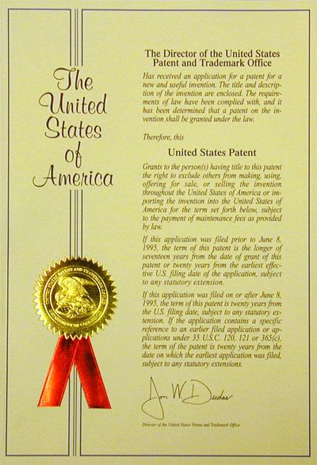
Patent rights only exist if “issued” by Government.
Patents only exist if issued/granted
Registration of TM and © is optional
Registration of TM and © boosts rights

Slide 10
Patent rights only exist if “issued” by Government.
Patents only exist if issued/granted
Registration of TM and © is optional
Registration of TM and © boosts rights
Significant hurdle

Slide 11
Patents have a short life always.
Type of IP | Lifespan
Patents | 20 years at most
Copyrights | 70+ years
Trademark, trade secret, know how | Forever potentially

Slide 12
Patents have a short life always.
Type of IP | Lifespan
Patents | 20 years at most
Copyrights | 70+ years
Trademark, trade secret, know how | Forever potentially
Essential
True or False: Patent rewards innovation.
True
False

Slide 13
Patents have a short life always.
Type of IP | Lifespan
Patents | 20 years at most
Copyrights | 70+ years
Trademark, trade secret, know how | Forever potentially
Essential
True or False: Patent rewards innovation and public disclosure.
True
False

Slide 14
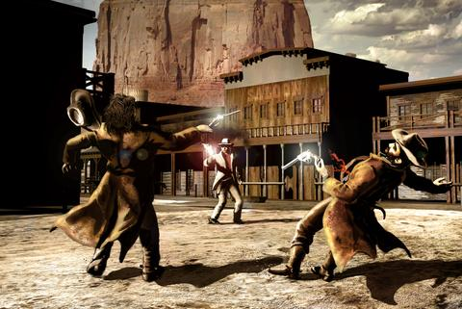
Patents are easiest to kill.
Dagnabbit. I might be:
Not infringed
Invalid
Unenforceable
Misused
Owned by someone else
Ineligible
Inoperable
Not enabled
No written description
Licensed
Exhausted
© Philcold© Philcold | Dreamstime.com© Philcold | Dreamstime.com - Duel In The Street Photo

Slide 15
Patents are easiest to kill.
Dagnabbit. I might be:
Not infringed
Invalid
Unenforceable
Misused
Owned by someone else
Ineligible
Inoperable
Not enabled
No written description
Licensed
Exhausted
Frustrating
Majority are negated in litigation
Anti-patent bias in courts/USPTO
Other IP much harder to kill

Slide 16
Patents are hardest to enforce.
Less respect
Warning letters less effective
Business culture applauds patent challenges
Majority fail to survive litigation
© Martinmark© Martinmark | Dreamstime.com© Martinmark | Dreamstime.com - Funny Sign Woman Photo

Slide 17
Patents are hardest to enforce.
Less respect
Warning letters less effective
Business culture applauds patent challenges
Majority fail to survive litigation
Disappointing
© Martinmark© Martinmark | Dreamstime.com© Martinmark | Dreamstime.com - Funny Sign Woman Photo

Slide 18
Key foible of Patent System is unclear rules.
Bright Line Rule Guides:
If A, then B.
Totality of circumstances rule fails to guide clearly:
If A, B, C, D, E, F, then potentially G or H, or neither
So many important patent law rules are evaluated using the totality of circumstances.

Slide 19
Almost all patent laws use the totality of circumstances approach
SPEED LIMIT
SPEED LIMIT
30
Not too fast.
Not too slow.
Non-patent rule
Patent rule
Outcomes are hard to predict.

Slide 20
Almost all patent laws use the totality of circumstances approach
Insider trading (Section 16b):
Corporate insider must wait 6 months to profit on company stock.
Insider trading (patent style):
Corporate insider must wait sufficiently long before profiting on company stock.
Non-patent rule
Patent rule
Outcomes are hard to predict.

Slide 21
Almost all patent laws use the totality of circumstances approach
Insider trading (Section 16b):
Corporate insider must wait 6 months to profit on company stock.
Insider trading (patent style):
Corporate insider must wait sufficiently long before profiting on company stock.
Possibly essential to fundamental fairness?
30
Non-patent rule
Patent rule
Outcomes are hard to predict.

Slide 22
Patents are a right to exclude, not a right to practice.
A heliostat system, comprising:
Central tower
Heliostats that concentrate sunlight onto the tower
Molten salt heated by the concentrated sunlight to store thermal energy
Steam turbine coupled to the heated salt and included steam heated by the molten salt to drive the turbine to generate electricity
Competitor Acme patent. Issued 2004. Still in force.
‹#›

Slide 23
Patents are a right to exclude, not a right to practice.
A heliostat system, comprising:
Central tower
Heliostats that concentrate sunlight onto the tower
Molten salt heated by the concentrated sunlight to store thermal energy
Steam turbine coupled to the heated salt and included steam heated by the molten salt to drive the turbine to generate electricity
A heliostat system, comprising:
Central tower
Heliostats WITH HOLOGRAPHIC MIRRORS that concentrate sunlight onto the tower
Molten salt heated by the concentrated sunlight to store thermal energy
Steam turbine coupled to the heated salt and included steam heated by the molten salt to drive the turbine to generate electricity
Competitor Acme patent. Issued 2004. Still in force.
Good Guys Innovation 2015
‹#›

Slide 24
Patents are a right to exclude, not a right to practice.
A heliostat system, comprising:
Central tower
Heliostats WITH HOLOGRAPHIC MIRRORS that concentrate sunlight onto the tower
Molten salt heated by the concentrated sunlight to store thermal energy
Steam turbine coupled to the heated salt and included steam heated by the molten salt to drive the turbine to generate electricity
A heliostat system, comprising:
Central tower
Heliostats that concentrate sunlight onto the tower
Molten salt heated by the concentrated sunlight to store thermal energy
Steam turbine coupled to the heated salt and included steam heated by the molten salt to drive the turbine to generate electricity
ACME owns dominating patent.
Good Guys can’t practice its own innovation
ACME can’t practice Good Guys innovation
Competitor Acme patent. Issued 2004. Still in force.
Good Guys Innovation 2015
‹#›

Slide 25
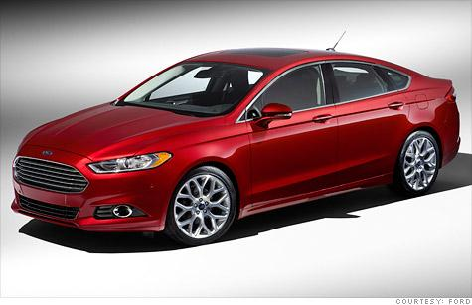
Patents are a right to exclude, not a right to practice.
NO OTHER PROPERTY WORKS THIS WAY!!!
If all you get is a right to exclude, would you ever buy a car?
‹#›

Slide 26
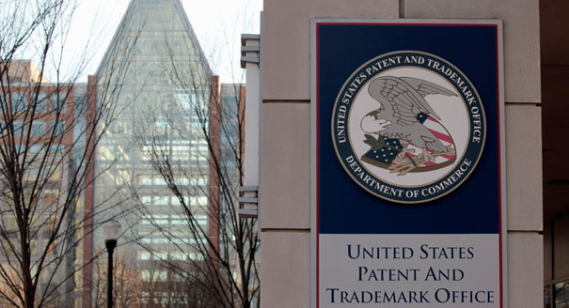
So many drawbacks!
Not Going Out of Business
Hard to get
Short life
No respect
Poor guidance
Expensive
Easy to kill
Right to exclude
So why are patents so important?

Slide 27
Why pursue patents?
Valuation
Contract provisions
Enable deals
Marketing
Protect technology
Establish ownership
Access other technology
Tax strategies
Enforce

Slide 28
Example Contract provision
Good Guys heliostat components and the other designated single use components of the Solar Power Systems are only licensed by Good Guys to Acme Customer Guys for a single use. More than one use is prohibited. Through training, videos, written instructions, and in other written, visual, or oral marketing communications, Acme Customer Guys and its sub-distributors shall use best efforts to ensure that end users use single use items only for a single heliostat.
Restrict use of proprietary components

Slide 29
Example Contract provision
Acme Customer Guys shall protect the confidential and proprietary nature of the Good Guys intellectual property and shall require any suppliers and sub-distributors to do the same.
Protect confidentiality

Slide 30
Example Contract provision
For any and all Good Guys Products manufactured by Acme, Acme must use Good Guys Critical Components and must procure these from Good Guys or from a source expressly authorized by Good Guys in writing.
Control sourcing for proprietary components

Slide 31
Example Contract provision
Acme shall not analyze or otherwise reverse engineer or have a third party analyze or otherwise reverse engineer any tangible embodiments of the Good Guys Intellectual Property Rights, including Good Guys Products, Good Guys Critical Components or Good Guys Product Specifications unless expressly authorized by Good Guys in writing, and all results of any such authorized analysis shall be considered Good Guys’s Confidential Information for purposes of this Agreement. These obligations, restrictions, and rights shall survive termination or expiration of this Agreement.
Protect against reverse engineering

Slide 32
Example Contract provision
Good Guys grants Acme a nonexclusive, non-transferrable, indivisible license to use the Good Guys Know How, Copyrights, and Patent Rights only to make the Good Guys Control Panel for Good Guys at the Designated Acme Facility in accordance with Good Guys Specifications. Acme shall not use the Good Guys Know How, Copyrights, and Patent Rights for any other purpose or for the benefit of any other party, person or entity other than Good Guys.
Use restrictions via license

Slide 33
It’s a wonderful patent life
Innovate and patent
Exclude others for limited time
Public domain
$$$$
Reward innovation
Increase technology for public domain
Encourage innovation.

Slide 34
Reward innovation v. Public domain
True or False: After a patent expires, you are free to practice the technology in the expired patent.
True
False

Slide 35
Reward innovation v. Public domain
True or False: After a patent expires, you are free to practice the technology in the expired patent.
True
False
Power of Contracts.

Slide 36
Power of contracts
Aronson (SCt 1979): Contract is king:
Contract obligation stops party from using information in the public domain.
Party must pay royalty forever for sales of unpatented products as payment for the right to initially use confidential know how to develop those products.
Royalty obligations can last forever if based on know how even if nothing is secret anymore and no patents exist.

Slide 37
Federal Circuit extends Aronson to post-agreement use restrictions.
Universal Gym Equipment Inc. v. ERWA Exercise Equipment Ltd., 4 USPQ2d 1035 (Fed. Cir. 1987).
Use restrictions can last forever if based on know how even if nothing is secret anymore and even if no patents exist.
Aronson says royalty can last forever
Universal Gym says restrictions on use can last forever
Know how is key

Slide 38
Reward innovation v. Public domain
True or False: After a patent expires, you are free to practice the technology in the expired patent.
True
False
Power of Contracts.
How can we make this statement true?

Slide 39
Reward innovation v. Public domain
True or False: After a patent expires, you are free to practice the technology in the expired patent unless you are otherwise contractually bound.
Power of Contracts.
True
False

Slide 40
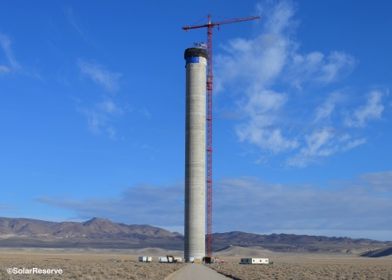
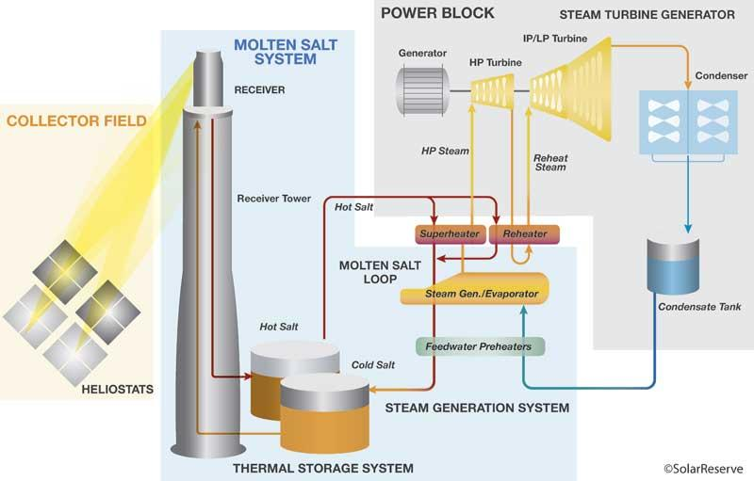
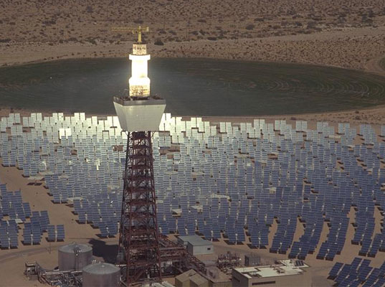
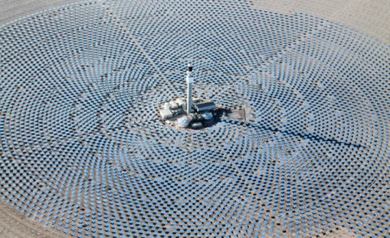
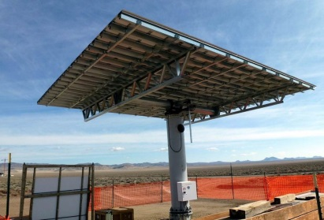
PCT Application system makes international filing more bearable
International filing is very expensive
PCT system allows $$$ to be deferred
For a price
Gives you more time to assess invention value

Slide 41
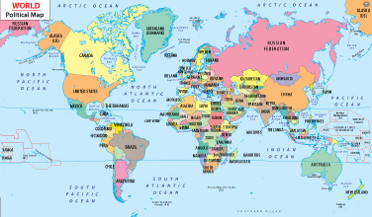
The PCT system was created to make international filing more bearable.
In the early days, you filed everywhere on Day 1.
Very expensive!!!
$$
$$
$$
$$
$$
$$

Slide 42
International treaties created to allow $$$$ to be deferred for one year.
$$
$$
$$
Day 1:
File your priority application
Day 365:
File internationally
$$
$$
$$
Still too expensive too soon.

Slide 43
The PCT system was created to make international filing more bearable.
Next, PCT treat placed to allow international filing to be delayed for 30 months . . . For a fee.
$$
$$
Day 1:
File your priority application
Month 12:
File PCT application
$$
Month 30,31:
File internationally
$$
$$
$$
$$
Better. Widely used today.
Notes:
‹#›

Slide 44
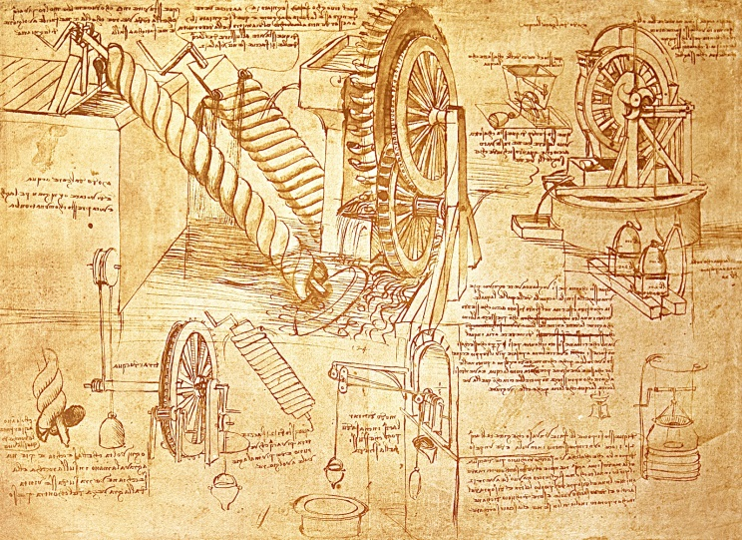
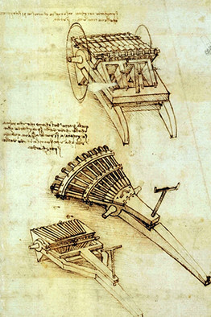
Provisional applications can be “quick and dirty”
File quickly to get a patent stake in the ground
Later nonprovisional claims priority to the provisional
Priority claim only valid if provisional has enablement, written description.
Quick and dirty provisional too informal to enable or provide written description
Same as doing nothing.

Slide 45
Provisional applications were created so US inventors have same patent term as OUS inventors.
Day 1:
OUS inventor files priority application
Year 1:
OUS inventor files US application
Year 21:
US Patent expires
Day 1:
US inventor files US application
Year 20:
US Patent expires
The situation before US provisionals were authorized.

Slide 46
Provisional applications were created so US inventors have same patent term as OUS inventors.
Day 1:
OUS inventor files priority application
Year 1:
OUS inventor files US application
Year 21:
Patent expires
Year 1:
US inventor files US nonprovisional application
Day 1:
US inventor files provisional application
Year 21:
Patent expires

Slide 47
Provisional applications are good buddies or false friends
Good buddy: more patent term
False friend: useless if too informal

Slide 48
Provisional recommendations
Quick and dirty only acceptable if no other option
Follow up quickly with more complete content
Content should be complete with some tolerance for informal presentation
Big company practice: “formal” provisionals

Slide 49
Thank you.
Boron
B
Potassium
K
Atomic Mass
Neodymium
A
Iodine
Nd
Erbium
Silver
Nitrogen
I
Er
Ag
N
Protons and Neutrons
5
10.811
60
19
144.24
39.098
53
68
47
7
126.90
167.26
107.87
14.007
Intellectual Property Attorneys
All the right elements.

