Slide 1
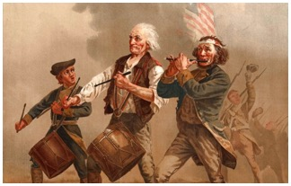
Snapshot 5: The Power of Know How
Title
Know How Strategies Avoid Many Agreement Pitfalls
David B. Kagan
Kagan Binder, PLLC
Stillwater, Minnesota
Presented to MNCLE
January 31, 2020
Snapshot!
Agreement Wisdom in a Flash!

Slide 2
Which Clause is better?
Licensor grants Licensee a nonexclusive, royalty bearing license to use TRADE SECRETS to make, use, sell, offer to sell, import, or otherwise distribute CAFFEINATED HEADBANDS anywhere in the world.
Licensor grants Licensee a nonexclusive, royalty bearing license to use KNOW HOW to make, use, sell, offer to sell, import, or otherwise distribute CAFFEINATED HEADBANDS anywhere in the world.

Slide 3
Compare features
Know How
Trade Secrets
Statutory
Narrow definition
Must be novel
Must be secret
Easy to lose
Maintenance 24/7
Contractual
Broad definition
Secrecy/novelty not required
Hard to lose
Maintenance free

Slide 4
Enforcement
Know How
Trade Secrets
Contract can burden Licensee to prove not know how
Can only enforce against contracting party:
Suppliers
Customers
Employees
Advisers
Distributors, etc.
Burden on Licensor to prove Trade Secret exists
Enforceable against the world
Both enjoy potentially indefinite life span and royalty stream

Slide 5
Enforcement
Know How
Trade Secrets
Contract burden on Licensee to prove not know how
Can only enforce against contracting party:
Suppliers
Customers
Employees
Advisers
Distributors, etc.
Statutory burden on Licensor to prove Trade Secret exists
Enforceable against the world
If secret and novel, your contractual know how can be enforceable against the world as a trade secret!
Both enjoy potentially indefinite life span and royalty stream

Slide 6
Licensor main objectives
Collect $$ on as much as possible
Easy to acquire
Easy to maintain
Easy to enforce
Hard to design around
Hard to kill
Hard to lose
Avoids plethora of pitfalls
Know How wins by shut out
Know How
Trade Secrets
8
0

Slide 7
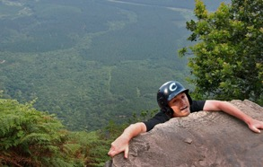
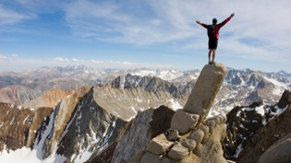
Know How Power
Patent and Know how Licensor
Patent Licensor
We will now see how know how strategies could have saved Licensor from falling off the cliff

