Slide 1
Patent Therapies: Prescriptions for Healthy Patents
Key prosecution mistakes you must avoid
Success strategies show winning prosecution principles
Paul W. Busse
David B. Kagan
Kagan Binder, PLLC
Suite 200, 221 North Main Street
Stillwater, Minnesota 55082
© 2003-2017 Kagan Binder, PLLC

Slide 2
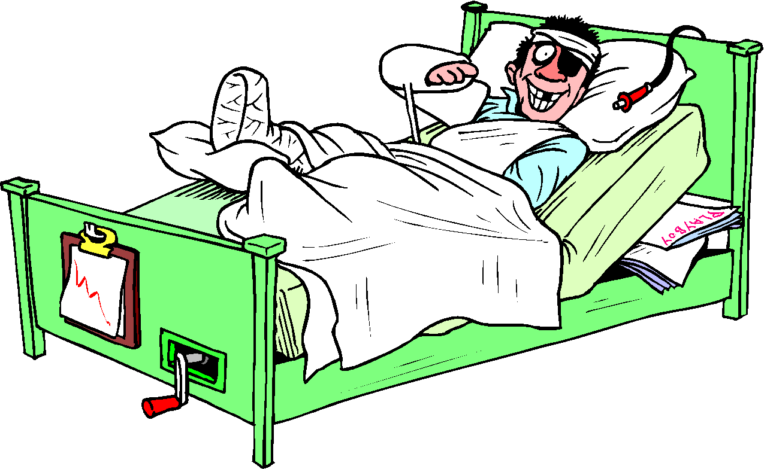
Patent Therapy helps prevent these sickly claims:
Placebo Claim
Vestigial Claim
Allergenic Claim
Fractured Flu
Common Cold Claim
Bloated Claim
Controversial 2001 outbreak
2017 infestation

Slide 3
PLACEBO CLAIM
CONDITION: Broad claim that gets surprisingly narrow claim construction.
I feel fine, doc.
Yes, but there’s nothing in there. Not a peep.

Slide 4
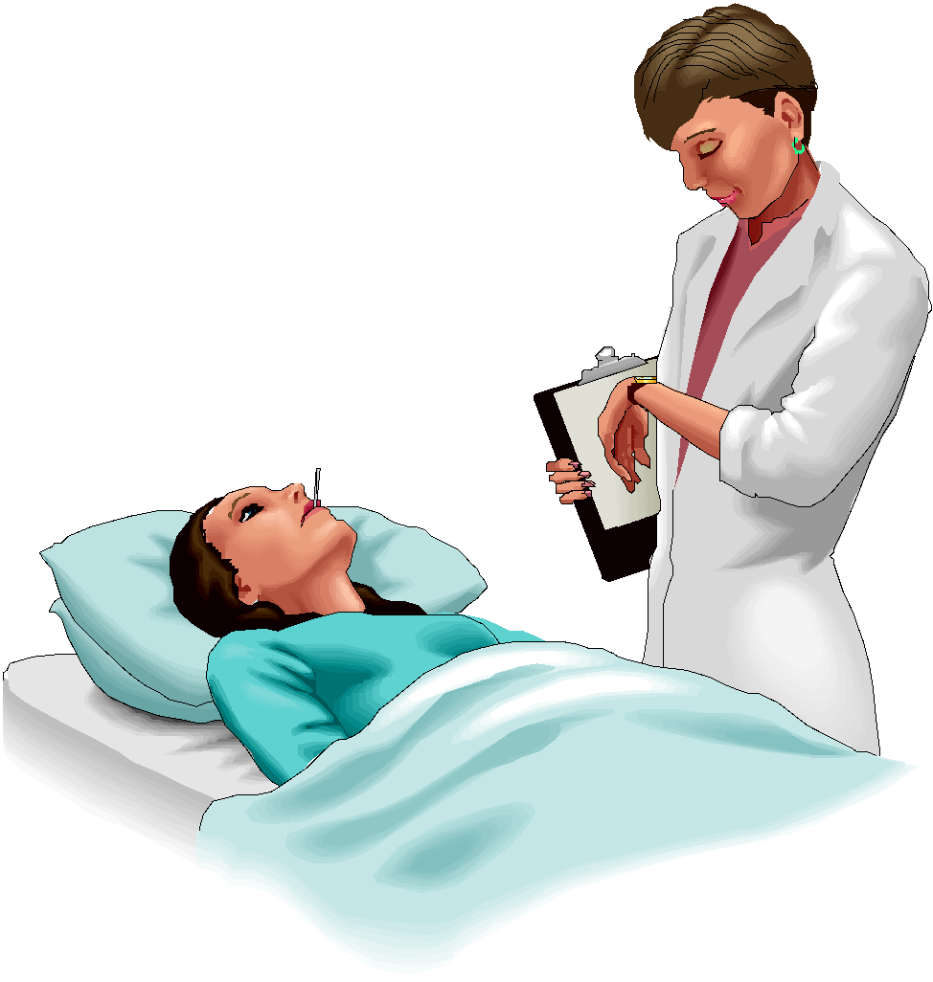
Viskase Corp. v. Amer. National Can Co.
Precisely 0.910.
About 0.91?
You caught this bug from your attorney.

Slide 5
Day Intl. Inc. v. Reeves Bros. Inc.
Below the melting point and in the range 110°F to 170°F.
Below the melting point?
You caught this bug from your attorney.

Slide 6
Ecolab Inc. v. Envirochem Inc.
Substantially uniform composition, not substantially uniform performance over time.
Substantially Uniform?
You caught this bug from your attorney.

Slide 7
Tegal Corp. v. Tokyo Elect. Amer. Inc.
Only glow discharge plasma and no other plasmas.
Plasma?
You caught this bug from your attorney.

Slide 8
Rheox Inc. v. Entact Inc.
Calcium orthophosphate but not TSP and not monocalcium orthophosphate.
Calcium orthophosphate?
You caught this bug from your attorney.

Slide 9
UCB, Inc. v. Yeda Research and Dev. Co., Ltd.
Yes, but not chimera or humanized monoclonal antibody
Monoclonal antibody?
You caught this bug from your attorney.

Slide 10
Scimed Life Systems v. Advanced Cardiovascular Systems
Dual lumen?
I’m afraid not, only co-axial.

Slide 11
Biovail Corp. Intl. v. Andrx Pharma. Inc.
Same old, same old.
Have I got a Placebo Claim again, doc?
This time, you caught it from a related prosecution history.

Slide 12
Lex Corp. v. Blue Pumpkin Software, Inc. and Omega Eng. V. Raytek Corp.
“Disclaimer”
“Disavowal”

Slide 13
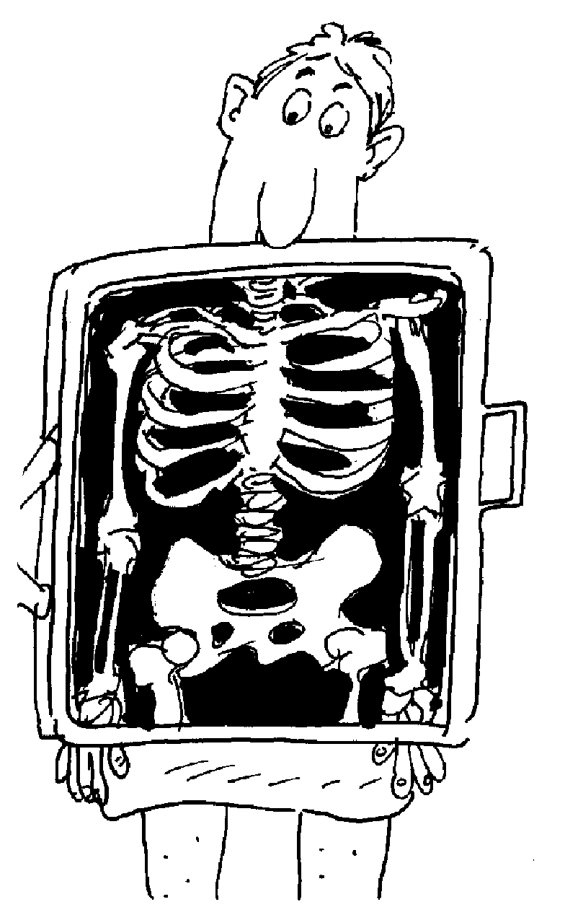
Cause of Placebo Claim easy to see:
Arguments are mismatched to claim scope or written description
Specification disavowal
Unsuccessful attempt to add claims that Examiner rejects, so you withdraw.
Questionable to mainstream (1997-2017)

Slide 14
SUCCESS STORY: Hostile Examiner Part 1 How do you cure Examiner hostility that poisons your claims?
Claims protect additive and innovative asphalt binder that foams
Huge processing advantages
Unpatentable balderdash! I hate these claims and your tie.
I will never, ever, ever, ever allow these claims or like your tie.

Slide 15
SUCCESS STRATEGY: How do you cure Examiner whose hostility is poisoning your claims?
Claims protect additive and innovative asphalt binder that foams
Huge processing advantages
Appeals can cure the hostile Examiner.
Have confidence
Avoid placebo arguments
Appeal consolidated 3 related cases
Claims allowed

Slide 16
SUCCESS STRATEGY: How do you cure Examiner whose hostility is poisoning your claims?
Your arsenal includes ethos, pathos, and not merely logos
Tell the story to put ethos and pathos to work
Interference: high school dropouts made amazing invention; opponent theme of “too stupid” offended judges
Prosecution: Pro bono story carried the day
Prosecution: Inventor won technical Oscar!

Slide 17
ALLERGENIC CLAIM (Prosecution Laches)
Condition: Claim that first appears irritatingly late in prosecution.
Unexpectedly established by CAFC in Symbol Technologies, Inc. v. Lemelson Med. Ed. & Res. Foundation(Fed. Cir. 2002).
Unreasonable and unexplained delay in presenting a claim. In the presence of intervening rights, claims are unenforceable.

Slide 18
ALLERGENIC CLAIM (Prosecution Laches)
Condition: Claim that first appears irritatingly late in prosecution.
Unexpectedly established by CAFC in Symbol Technologies, Inc. v. Lemelson Med. Ed. & Res. Foundation(Fed. Cir. 2002).
Accord: Whitserve LLC v. GoDaddy.com (2005)

Slide 19
DOES PROSECUTION LACHES APPLY TO ME?
“The Court applied the doctrine in Webster a year later and held that an unreasonable eight-year delay rendered the claims at issue unenforceable. . . . The Court went on to say that a two-year delay was prima facie evidence of unreasonableness. Id. at 471.”
Yes, but there are practical implications for everyone.
Weren’t the Lemelson facts unique?

Slide 20
SUCCESS STRATEGY: Hostile Examiner Part 2 How do you cure Examiner hostility that hates your whole company?
New assignment in your company
Acquisition
Examiner B
Examiner A

Slide 21
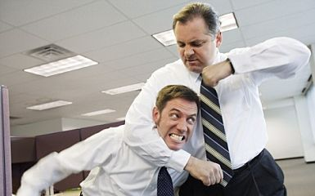
SUCCESS STORY: Hostile Examiner Part 2 How do you cure Examiner hostility that hates your whole company?
Source of both problems: Prior attorneys were bullies:
Arrogant
Disrespectful
Angry
Technically bad
Untrustworthy

Slide 22
WAR STORY: Hostile Examiner Part 2 How do you cure Examiner hostility that hates your whole company?
INTEGRITY RESPECT TRUST QUALITY
Interviews
Written work
Fixes relationships fast!!!!!
Essential in interference and IPR practice
Helped win the “unwinnable” interference
Dishonesty caused other side to lose all credibility with the judge

Slide 23
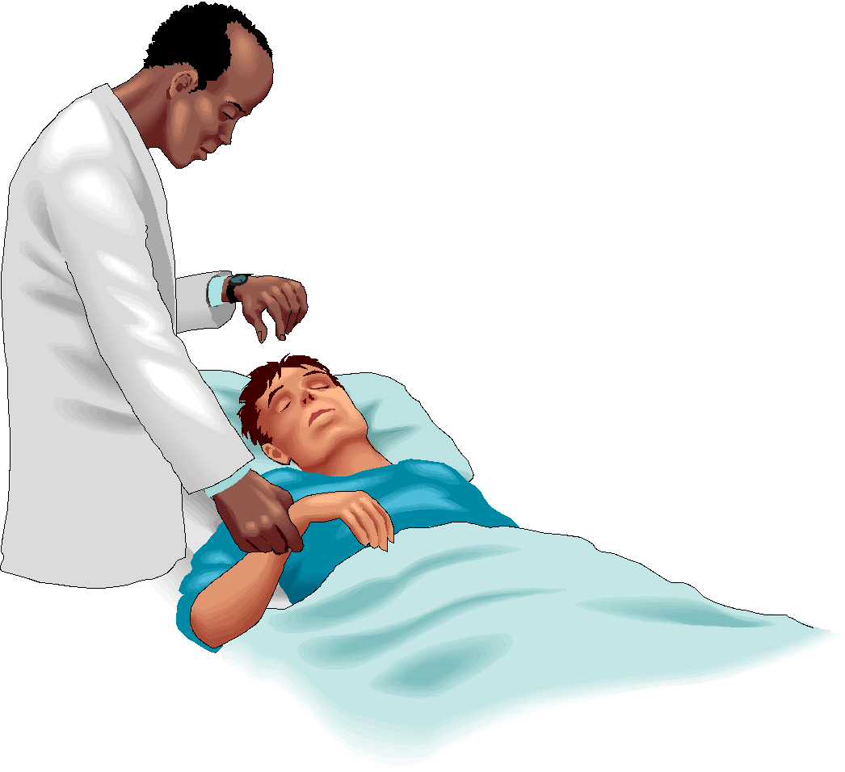
THE VESTIGIAL CLAIM
Condition: Totally useless claim that is inoperable and covers nothing
Hmmm. Bad function and/or bad theory of operability recited in the claim.
Give it to me straight, doc. What are my claim chances?
Sorry, pal. Your claims are invalid under 101 and 112.

Slide 24
HOW BAD IS MY VESTIGIAL CLAIM CONDITION, DOC?
Increasingly common in the cases
Very common in due diligence
Process Control (Fed. Cir. 1999)
Elekta (Fed. Cir. 2000)
EMI (Fed. Cir. 2001)
Talbert (Fed. Cir. 2002)
Cordis (Fed. Cir. 2008)

Slide 25
Claims reciting scientific theory are vulnerable to vestigialitis:
“ . . . administered under conditions effective to eliminate side effects by interfering with the ability of the virus to block said enzymatic activity . . .”
This claim recites a theory of why the invention works.
The “why” is wrong.
Claims recite bad function and/or bad theory of operability
Avoid “why” in your claims!!!

Slide 26
Bad function seasoned with bad science: EMI Group North America Inc. v. Cypress Semiconductor Corp.
No: “said refractory metal forming a cap to prevent evaporation of said fuse portion when said fuse portion is exposed to a directed energy source to increase the vapor pressure under the cap to produce an explosive removal of said portion[.]”
Yes. “...said refractory metal forming a protective element over at least a portion of the fuse portion in a manner effective to allow the fuse to be operatively triggered when exposed to . . .”
Proof. Proof. Proof.

Slide 27
Success Strategy: How do you deal with Section 112 barrage?
Transferred application
Rich in content, claims are “too cute”
22 Section 112 rejections over 31 pages
Vague, written description, enablement, kitchen sink
How do you respond to 22 rejections in less than one zillion pages?

Slide 28
WAR STORY: How do you deal with Section 112 barrage?
Claims 1-12 are rejected under 35 U.S.C. §112(b), second paragraph, as being indefinite for failing to particularly point out and distinctly claim the subject matter which the inventor regards as the invention. The Office Action indicates that the terminology relating to “process parameters” is unclear. Claim 1 is amended to recite a gas comprising stuff and/or things that is at temperature(s) and pressure(s) according to the recited conditions. It is respectfully submitted these amendments avoid the rejection. The other claims depend from the amended claim. Withdrawal of the rejection is respectfully requested.
Efficient!
Amend to make clear
Very streamlined remarks
Claim fixes “speak for themselves”

Slide 29
FRACTURED FLU
Condition: Divided claim is a fractured claim.
Can you diagnose this claim’s illness?
A method of treating metagorganoplexius, comprising:
Making oxymetagorgane;
Evaluating blood for the presence of m.gorganoplexius antibodies;
Prescribing oxymetagorgane; and
Ingesting oxymetagorgane.

Slide 30
FRACTURED FLU
Condition: Divided claim is a fractured claim.
One claim, one infringer.
A method of treating metagorganoplexius, comprising:
Making oxymetagorgane;
Evaluating blood for the presence of m.gorganoplexius antibodies;
Prescribing oxymetagorgane; and
Ingesting oxymetagorgane.

Slide 31
FRACTURED FLU
Claims suffering from “divided infringement” have a poor prognosis.
Direct infringement requires a SINGLE party to practice all method steps.
Can acts of multiple parties ever be combined?
Yes, but it’s hard to prove the single party exceptions.

Slide 32
FRACTURED FLU
Exceptions to the one claim/one infringer rule***
One party directs or controls the other(s)
Joint enterprise
(New) Access, benefit, participation conditioned on performing patent step(s) in prescribed way
***Attempts to prove exceptions often fail. Use one claim/one infringer drafting.

Slide 33
FRACTURED FLU
Claims suffering from “divided infringement” have a poor prognosis.
BMC. V. Paymentech (Fed. Cir. 2007)
Akamai Tech., Inc. v. Limelight Networks, Inc. V (en banc) (Fed. Cir. 2015)
Medgraph, Inc. v. Medtronic, Inc. (Fed. Cir. 2016)

Slide 34
SUCCESS STRATEGY
Preparation Preparation Preparation
Unwinnable interference? Junior party by 17 months
Pivotable moment was cross examination of our priority expert
Defending the witness at the cross is not the hard part
Preparing the witness ahead of time is crucial and challenging:
How to behave 5%
Defend Issues 95%
Senior party stuck to its filing date; we proved conception and reduction to practice shortly before that

Slide 35
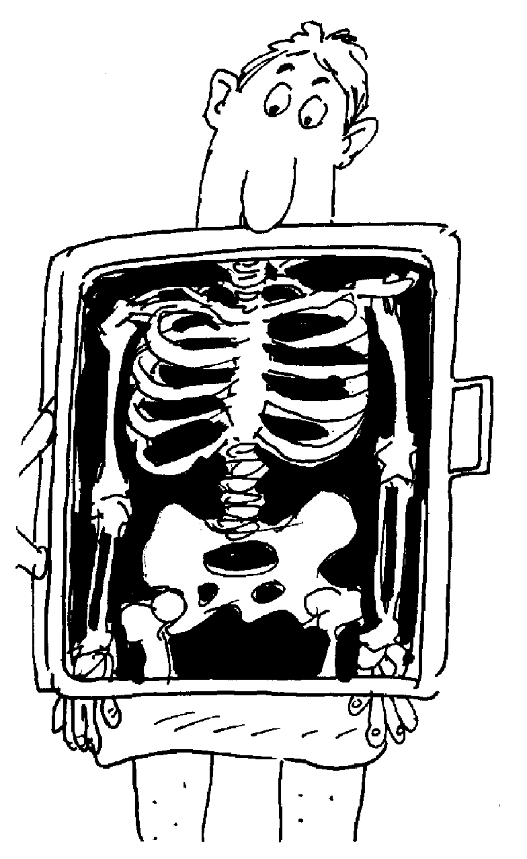
COMMON COLD
Condition: Claims that “catch” prosecution history estoppel from OTHER prosecution histories.
Unexpected sources of prosecution history estoppel
Prospective estoppel
Retroactive estoppel
Commonly owned estoppel

Slide 36
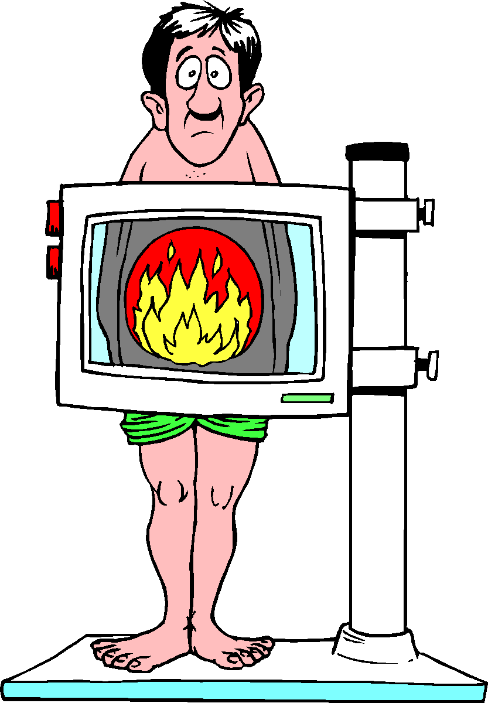
A COMMON SOURCE OF INFECTION: Your ancestors.
Prospective estoppel: past impacts present
Clearly, earlier prosecutions impact later claims
Many, many cases on point
Can the present impact the past? (Retroactive estoppel)

Slide 37
DOES RETROACTIVE ESTOPPEL EXIST?
Rationale of “prospective” cases suggests no, but...
Foreign counterparts are relevant (Tanabe Seiyaku Co.v. US ITC; Baxter Healthcare v. HQ Speciality Pharma Corp.)
Later U.S. prosecution explored by CAFC in construing earlier claims (Desper Products, Inc. v. Qsound Labs, Inc.)
+
Yes.

Slide 38
CATCHING THE COMMON COLD FROM YOUR NEIGHBOR
Perhaps a commonly-owned, but otherwise unrelated patent, could infect your claims!
Aagh! That would be awful!
Estoppel might not be your own, but that of your colleague down the hallway.
Tough when multiple patent staff persons patent work for the same business unit!

Slide 39
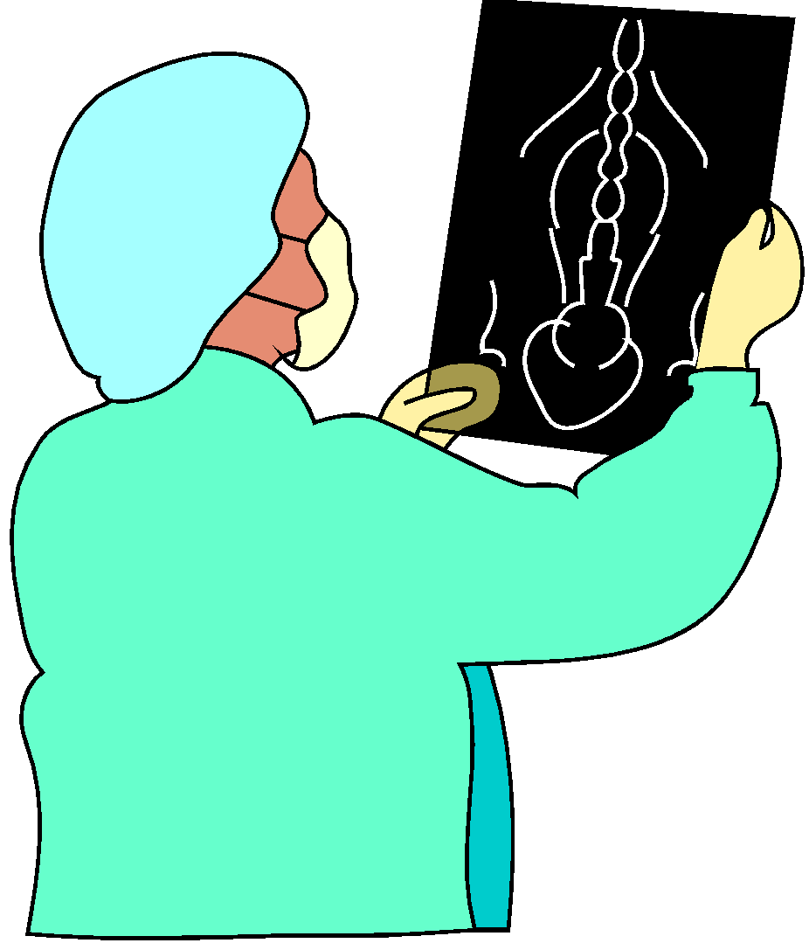
CATCHING THE COMMON COLD FROM YOUR NEIGHBOR: Viskase Corp. v. Amer. Natl. Can Co.
Two legally unrelated patents
Commonly owned, related subject matter
Common limitation
Aagh! CAFC used one in construing terms in the other.

Slide 40
Compare the Viskase case to Abbott Labs. v. Dey
No estoppel between commonly-owned patents.
Later patent had common inventor and common subject matter
Later patent legally un-related
“different composition”
Added limitation.

Slide 41
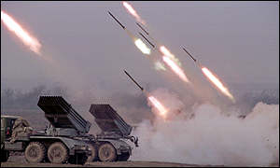
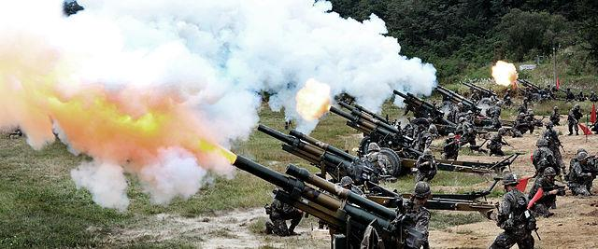
SUCCESS STRATEGY
How do you defend against barrage of multiple reexamination and IPR attacks (5 for us, 125 for a poor company (Zond) out east!!!)
Warm mix asphalt with amazing additive; many advantages
5 reexaminations launched by 2 requestors; parallel litigation
Low survival chances????

Slide 42
SUCCESS STRATEGY
How do you defend against barrage of multiple reexamination and IPR attacks (5 for us, 125 for a poor company (Zond) out east!!!)
YOU CAN’T WIN IF YOU GIVE UP
2/5 consolidated
Claims upheld in all 4 Reexaminations
Vigorous attack ≠ sound attack
Volume ≠ quality
Thorough preparation was key
INTEGRITY RESPECT TRUST QUALITY
Warm mix asphalt with amazing additive; many advantages
5 reexaminations launched by 2 requestors; parallel litigation
Low survival chances????

Slide 43
THE BLOATED CLAIM
Condition: A Markush claim is stuffed with Markush members, but fails to be assisted by pressure-relieving dependent claims.
You don’t look surprised to see me, doc.
Vulnerable to validity attacks
Common in pharmaceutical and chemical patents

Slide 44
A RECENT BLOATED CLAIM THAT SUCCUMBED UNDER THE STRAIN OF BATTLE:
“A method of using compound X for purpose A or purpose B.”
MSM Investments Co. v. Carolwood Corp. (Fed. Cir. 2001)
Simplest Markush claim imaginable: only 2 members
Fresenius USA, Inc. v. Baxter Intl., Inc. (Fed Cir 2013)

Slide 45
MSM CLAIM: A METHOD OF USING COMPOUND X FOR PURPOSE A OR B
Result: Claim invalid.
Accused infringer is a happy camper!
A arguably patentable.
B is in public domain.
No dependent claim to A.
Infringer using X for purpose A.

Slide 46
BLOATED CLAIM PRESCRIPTION:
“2. The method of claim 1, wherein compound X is used for purpose A.”
Use dependent claims for key species
If the MSM patentee had done this, the infringer would not have been able to enter the market unfettered
Avoid Markush claims in the IPR world.

Slide 47
BLOATED CLAIM and Patent owner estoppel:
“2. The method of claim 1, wherein compound X is used for purpose A, B, or C.”
Section 42.73(d)(3)(estoppel):
Patent applicant or owner: A patent applicant or owner is precluded from taking action inconsistent with the adverse judgment, including obtaining in any patent . . . A claim that is not patentably distinct from a finally refused or canceled claim[.]

Slide 48
Avoid Markush Claims in the IPR world
“Bloated” Markush listing does no work (work = more patentable; claim differentiation; claim construction; definiteness, etc.)
More vulnerable to prior art attack
Patent owner estoppel could limit the ability to pursue patentable species A if non-novel species B caused claim to be lost

Slide 49
Patent Therapy helps prevent these sickly claims:
Placebo Claim
Vestigial Claim
Allergenic Claim
Festo Flu
Common Cold Claim
Bloated Claim
I feel better already!

Slide 50
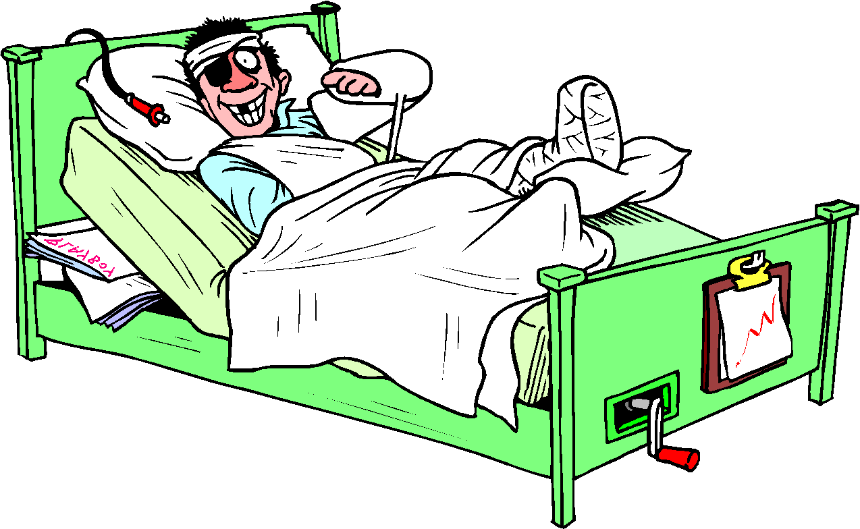
Patent Therapy leads to success:
Integrity, Respect, Trust, Quality
Ethos, pathos, and logos
Use appeals and other procedure tools effectively
Preparation Preparation Preparation
You can’t win if you give up.
Prosecute efficiently
Feeling better! Case law lessons are great medicine!

Slide 51
Patent Therapies: Prescriptions for Healthy Patents
Thank you very much for your time.
Paul W. Busse
David B. Kagan
Kagan Binder, PLLC
Suite 200, 221 North Main Street
Stillwater, Minnesota 55082

