Slide 1
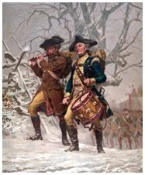
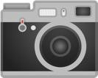
Snapshot 6: Did a quiet shift in the exhaustion doctrine just make licensed patents stronger?
Title
Replacement parts and consumables more protectable?
David B. Kagan
Kagan Binder, PLLC
Stillwater, Minnesota
Presented to MNCLE
January 31, 2020
Snapshot!
Agreement Wisdom in a Flash!

Slide 2
Over decades, exhaustion has relentlessly expanded, weakening patents more and more
Precursors
United States v. Univis Lens Co., 316 U.S. 241 (1942)
Quanta Computer, Inc. v. LG Electronics, Inc., 553 U.S. 617 (2008)
Lifescan Scotland, Ltd. V. Shasta Technologies, LLC, 108 USPQ2d 1757 (Fed. Cir. 2013)
Keurig, Inc. v. Sturm Foods, Inc., 108 USPq2d 1648 (Fed. Cir. 2013)
Impression Products, Inc. v. Lexmark International, Inc., 137 S. Ct. 1523(2017)
Methods
Consummables
Post-sale restrictions; international sales

Slide 3
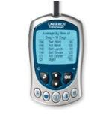
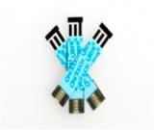
Scary Scenario A: Lifescan (2013)
Sale of unpatented meter exhausted method patent
Third parties can sell consumable strips

Slide 4
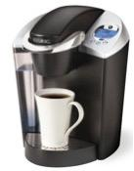
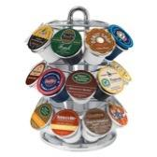
Scary Scenario B: Keurig (2013)
Sale of patented brewer exhausted method claims
Third parties can sell K-cups without infringement
Irrelevant: Many noninfringing uses
Irrelevant: Cups are patented
‹#›

Slide 5
Did a sneaky 2019 decision dramatically change the exhaustion landscape for consumables?
Auto. Body Parts Ass'n v. Ford Glob. Techs., LLC
2018-1613 (Fed. Cir. Jul. 23, 2019)
IPO rated the decision only 2/4 stars. Does the case deserve more stars?

Slide 6
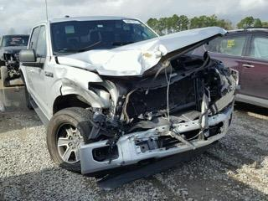
Does sale of F150 exhaust patent rights in replacement parts?
Patented hood (design patent)
Looks like a winner for Auto Body Parts, right?
Auto Body Parts sells replacement hoods
Ford sues for design patent infringement
Auto Body Parts argues exhaustion
In its brief, it relies on Lifescan and Keurig cases

Slide 7
Federal Circuit rules patent rights protect replacement parts, so Auto Body Parts infringes
Surprise!
Exhaustion only applies to something sold by patentee
Completely ignores Lifescan and Keurig
1865: sewing machine and needles
1894: cutting machine and knives
The fact examples involve utility patents and consumables. What is left of Lifescan and Keurig?

Slide 8
Exhaustion Conclusion
Opens door to more license and collaborative research strategies
Patent your consumables and replacement parts
Watch out for infringement risk if you sell replacement parts or consumables
If your pending litigation involves exhaustion or implied license issues, you should know about this case

Slide 9
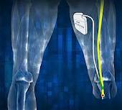
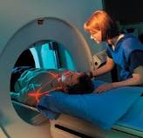
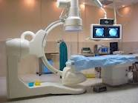
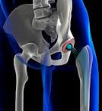
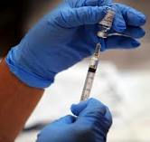
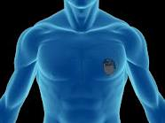
Thank you.
David B. Kagan
Presented to MNCLE
January 31, 2020
Boron
B
Potassium
K
Atomic Mass
Neodymium
A
Iodine
Nd
Erbium
Silver
Nitrogen
I
Er
Ag
N
Protons and Neutrons
5
10.811
60
19
144.24
39.098
53
68
47
7
126.90
167.26
107.87
14.007
Intellectual Property Attorneys
All the right elements.

